Slide 1

WPCS Workweek Overtime Exemption Request Process

Slide 2
Viewing Instructions:
Select the “Slide Show” Tab in PowerPoint.
Adjust computer for audio content.
Click to play “From Beginning”.
This slide will automatically advance after 5 seconds.
If the presentation must be paused, select “Pause” or “End” from the additional options in the lower left-hand corner of the presentation screen.
Play “From Current Slide” to restart.
If you prefer to review the slides without audio, click below to open the audio transcript.
Audio Transcript

Slide 3
Common Acronyms
Acronym | Term/Phrase
CMT | Care Management Team
DHCS | Department of Health Care Services
HCBA | Home and Community-Based Alternatives
IHSS | In-Home Supportive Services
OT | Overtime
WA | Waiver Agency
WPCS | Waiver Personal Care Services

Slide 4

What is Overtime?
Welfare & Institutions Code (WIC) 12300.4. establishes Overtime (OT) rules.
OT is when a Provider works over:
  8 hours per day AND
  40 hours per work week.
A work week is 12:00 a.m. Sunday to 11:59 p.m. Saturday.
OT pay is one and a half times the county pay rate.

Slide 5



Overtime Limits
No Waiver Provider may work more than:
  283 total hours of IHSS plus WPCS hours in a month.
  12 hours in a day.
  If working for only one Participant, no more than 70 hours and 45 minutes per work week.
  If working for more than one Participant, no more than 66 hours per work week.
284
283

Slide 6
Overtime Violations
If a Provider exceeds the standard weekly limits or exceeds the amount of approved OT hours they will receive an OT violation.
First Violation | Violation notice and dispute rights will be mailed to the Provider. Copy of the violation notice will be mailed to the Participant.
Second Violation | Violation notice, dispute rights, and training packet will be mailed to the Provider. The Provider has a one-time option to review the training material and return the training completion form to DHCS in order to remove their second violation. Violation notice will also be mailed to the Participant.
Third Violation | Violation notice and State Administrative Review rights information will be mailed to the Provider and Participant. The Provider will be suspended from WPCS and IHSS for 90 days.
Fourth Violation | Violation notice and State Administrative Review rights information will be mailed to the Provider and Participant. The Provider will be terminated from WPCS and IHSS for one year.

Slide 7

What is an Overtime Exemption?
OT Exemptions allow Providers to work:
  Up to 360 hours a month.
  Up to 12 hours per day.
An OT Exemption request must be approved before the Provider can claim OT hours beyond standard limits of 283 hours/month.
OT Exemptions are not back dated.

Slide 8
Which Exemption Applies?
Exemption 1 | Exemption 2
Participant enrolled on or before January 31, 2016 | Participant enrolled after January 31, 2016
Functional or behavioral needs require that the IHSS and/or WPCS services be provided by a specific Provider AND | At least one of these are true: 1, 2, 3, or 4 (see DHCS 2279, page 3) AND
One or more of these are true: i, ii, or iii (see DHCS 2279, page 2) | DHCS agrees that there are no other possible Providers to assist with the Participant’s care
Complete Exemption 1, A-F on page 4-5 | Complete Exemption 2, A-I on pages 5-7
Approved OT exemptions are valid for one year. Some may be valid with no end-date if both the Participant and Provider enrolled with the Waiver prior to January 31, 2016 | Approved OT exemptions are valid for one year

Slide 9


Exemption 1 Requirements
For Participants enrolled in the HCBA Waiver before 01/31/2016, the following requirements must be met:
The Provider/Participant must prove the Participant has functional and/or behavioral needs which require the services be provided by the Provider in question, AND at least one of the following:

Slide 10

Exemption 1 Requirements Continued
(Items (i)-(iii) are found on Page 2 of the Waiver Personal Care Services (WPCS) Workweek Overtime Exemption Request form.)
(i) The Provider lives in the same home as the Participant at least 5 days and nights per week on a regular basis,
OR
(ii) The Provider currently provides care to the Participant at least 8 hours per day, and has done so for two or more years continuously,
OR
(iii) The Participant is unable to find an additional local caregiver who speaks the same language as the Participant.

Slide 11

Exemptions Without an End Date
An OT Exemption will be granted without an end date if:
Participant was enrolled Waiver prior to January 31, 2016, AND
Provider was working for them prior to January 31, 2016, AND
Meet the requirements outlined in previous slides.
  If the Provider started working after January 31, 2016, they must renew their OT exemption annually.

Slide 12



Exemption 2 Requirements
For Participants enrolled in the HCBA Waiver AFTER
January 31, 2016, at least one of the following must be met:
1. The Provider lives with the Participant at least 5 days and nights per week, on a regular basis.
2. The Provider is providing consistent care to the Participant at least 8 hours a day, and has done so for at least 2 or more years continuously.

Slide 13


Exemption 2 Requirements Continued
3. The Participant is unable to find another caregiver who speaks the same language as the Participant.
4. The Provider provides WPCS care for more than one Waiver Participant.
Additionally, DHCS must agree there are no other Providers available to assist with the Participant’s care.
(Items 1-4 are found on page 3 of the Waiver Personal Care Services (WPCS) Workweek Overtime Exemption Request form)

Slide 14
Pre and Post 01/31/2016 OT Exemption Approval Examples
Pre 01/31/2016 | Post 01/31/2016
Participant: enrolled in the Waiver program since 2015 and requires 24-hour care Provider: providing care since 2015 to current 8 hours a day. | Participant: enrolled in the Waiver program since 2020, is ventilator dependent, g-tube fed, and non-ambulatory. Provider: providing care 5 days/nights per week since 2020 and lives in the same home.
Participant: enrolled since 2014, is non-ambulatory, requires full assistance with all activities of daily living, etc. Provider: providing care 6 days/nights a week since 2014, and lives in the same home | Participant: enrolled in the Waiver program since 2017, has advanced multiple sclerosis, etc. requires supervision/assistance with all daily activities and medical appointments. Provider: providing care since 2017 to current 8 hours a day
Participant: enrolled in the Waiver program since 2013, dependent on others for all activities of daily living, is non-verbal and communicates with gestures, etc. Provider: providing care 8 hours a day since 2013. | Participant: enrolled since 2019, has chronic inflammatory demyelinating polyneuropathy (CIDP), etc., lives in an area of only 53,000 Provider: only person within 30 miles who speaks participant's language of Urdu, care since 2019

Slide 15

How can a Provider/Participant demonstrate that there are no other Providers available?
Proof of Providers Declining Employment
The Participant/Provider must work with the WA, or DHCS nurses in counties with no WA, to find other Providers. These attempts to find other Providers must be documented and submitted with the application.

Slide 16

Reasons
Acceptable reasons why searches for Providers may be unsuccessful:
  1. Participant lives in a rural area so there may not be many Providers available.
  2. Unable to find Providers who speak Participant’s language.
  3. Participant’s functional and/or behavioral care needs are those which require a specific Provider.

Slide 17
Examples of Unsuccessful Provider Searches
Example 1:
Participant only speaks Farsi.
Example 2:
Participant lives in a remote area.
Example 3:
Participant posts help wanted on social media and searches the IHSS provider registry.
Lives in a small, remote area with a Spanish and English speaking population (42,000 people).
Posts on social media. No one responds.
Posts help wanted ads in the local paper and distributes flyers at their local church.
2 people replied: 1 never showed up and the other never messaged back.
3 providers started, but none stayed for more than a week.
The post states that Providers must learn to use a lift and breathing tube.

Slide 18

Written Proof
The Participant/Provider/WA must submit written proof of the following to DHCS:
  1. Copies of the ads placed searching for Providers.
  2. A written explanation of the response/lack of response to the ads. AND

Slide 19
Written Proof Continued
3. Written verification that the Public Authority was contacted for a Provider Registry with an explanation of what actions were taken with the list, including names and phone numbers or email addresses of providers contacted.
4. Written verification from Home Health Agencies and Personal Care Agencies with an explanation of what actions were taken with the contacts, preferably, on the agency’s letterhead. AND

Slide 20

Written Proof Continued
5. A written explanation of all other efforts made to find other Providers, including names, dates, and contact information for all potential Providers who were contacted and why they were not hired.

Slide 21

Waiver Agency Responsibilities
Assist with completing forms, searching for Providers, and obtaining required documentation.
Review completed forms (DHCS 2279), determine if requirements are met, and issue an approval or denial.
If denied, sends denial notice to the Participant & Provider with instructions on how to request a secondary review.
Send approved forms (DHCS 2279) to DHCS.
For DHCS approved exemptions, sets up “Task” in MedCompass six weeks prior to the OT exemption end-date to complete renewals, if necessary.​

Slide 22
How to Request an OT Exemption?
Click here for form DHCS 2279
Tips for Filling out the Forms

Slide 23
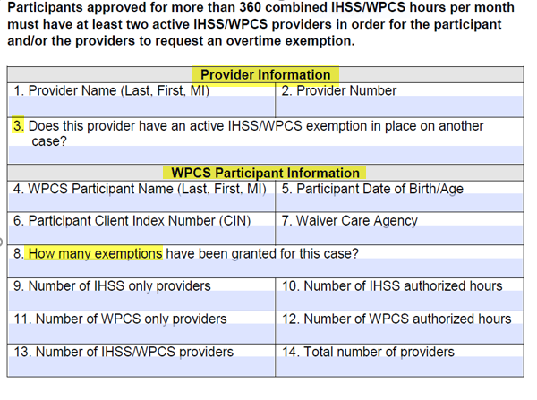

Page 1 of 9
DHCS 2279

Slide 24
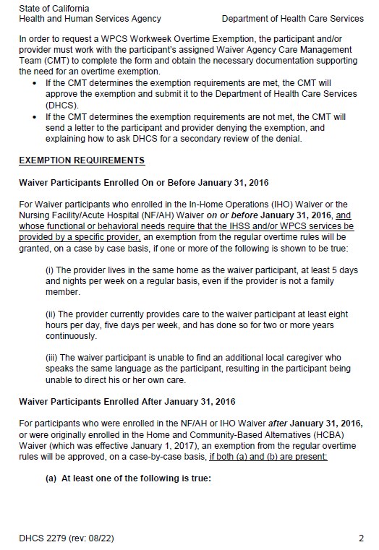

Page 2 of 9
DHCS 2279

Slide 25
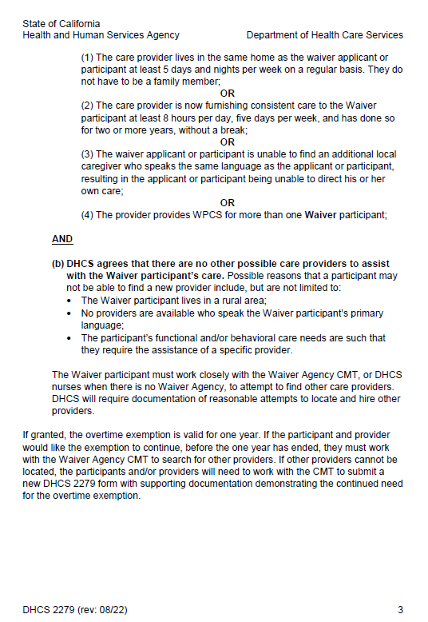

Page 3 of 9
DHCS 2279

Slide 26

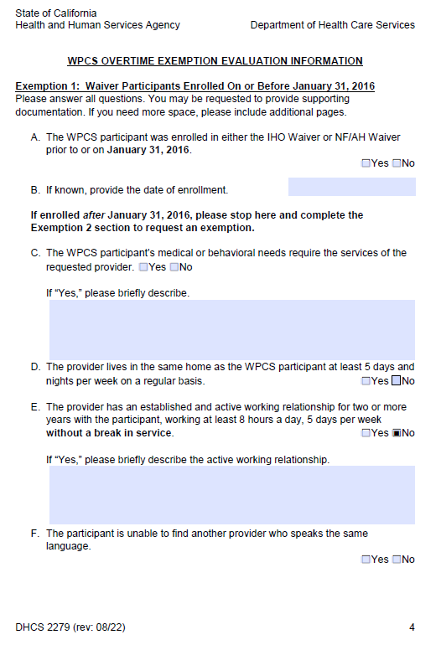
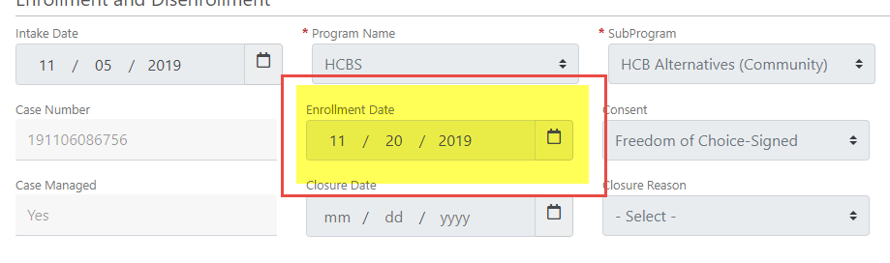
Page 4 of 9
From MedCompass
DHCS 2279

Slide 27
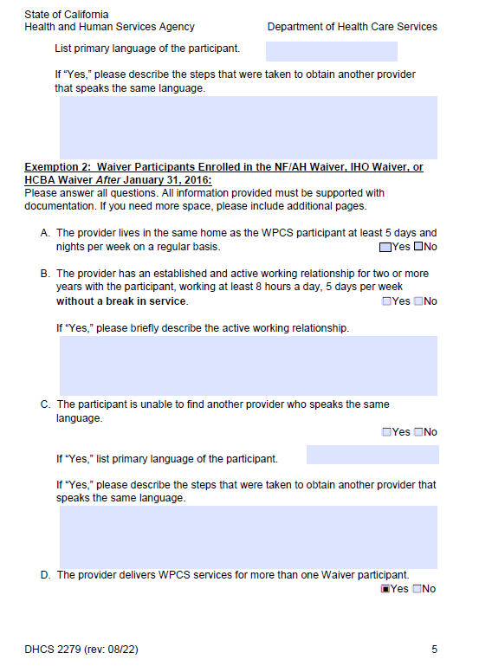


Page 5 of 9
DHCS 2279

Slide 28
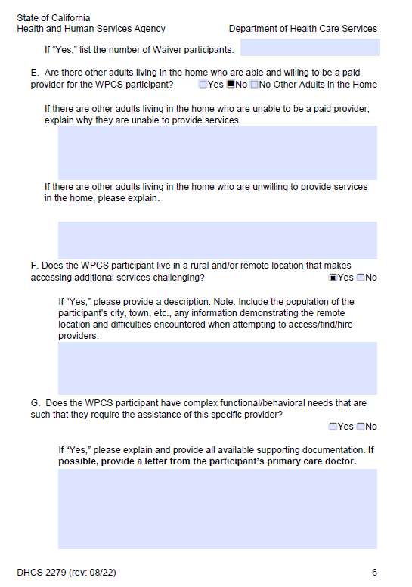

Page 6 of 9
DHCS 2279

Slide 29
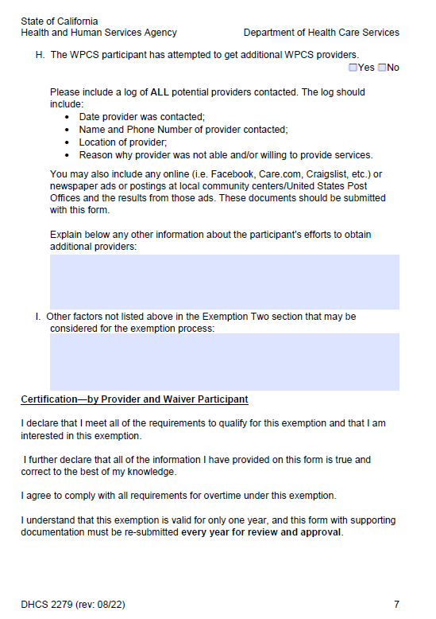

Page 7 of 9
DHCS 2279

Slide 30

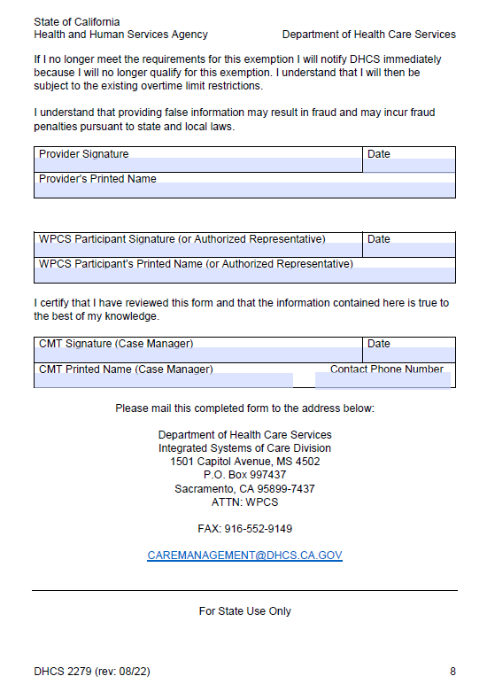
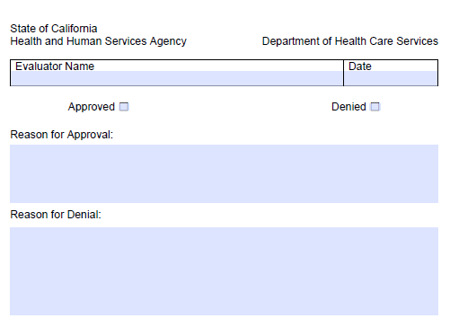
Page 8 and 9 of 9
DHCS 2279

Slide 31

Secondary Review Process
Click here for the Form DHCS 2280
If an OT Exemption request is denied but the Provider/Participant believes it should be approved, they may request a secondary review from DHCS.

Slide 32
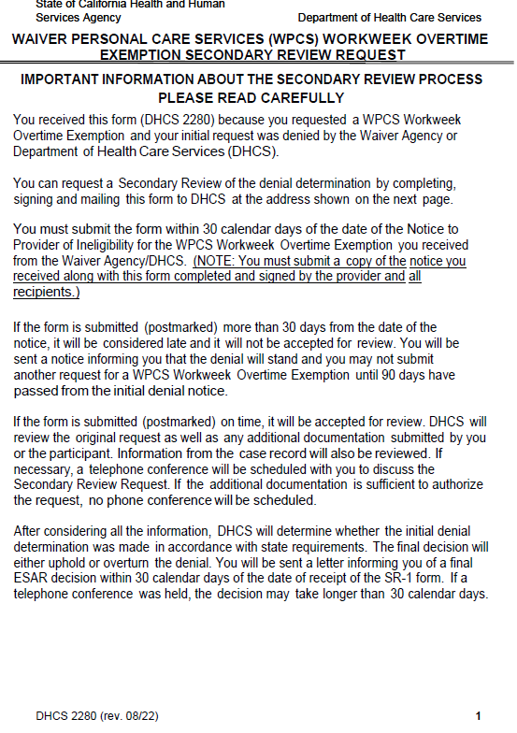

Page 1 of 5
DHCS 2280

Slide 33
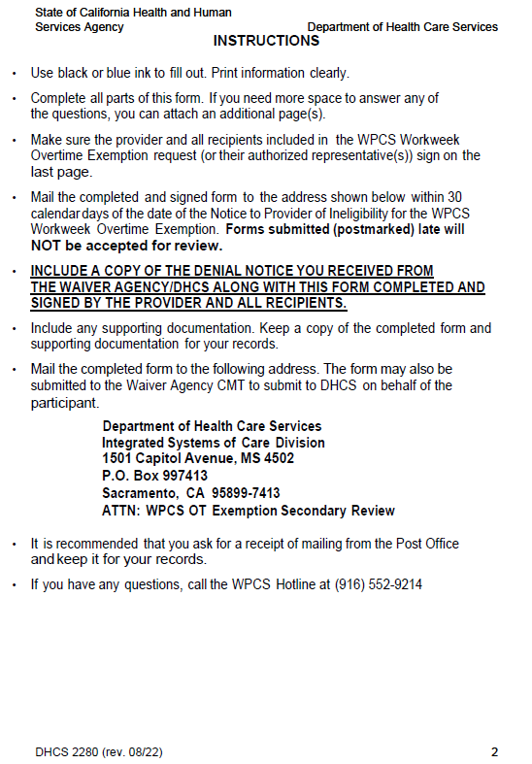

Page 2 of 5
DHCS 2280

Slide 34
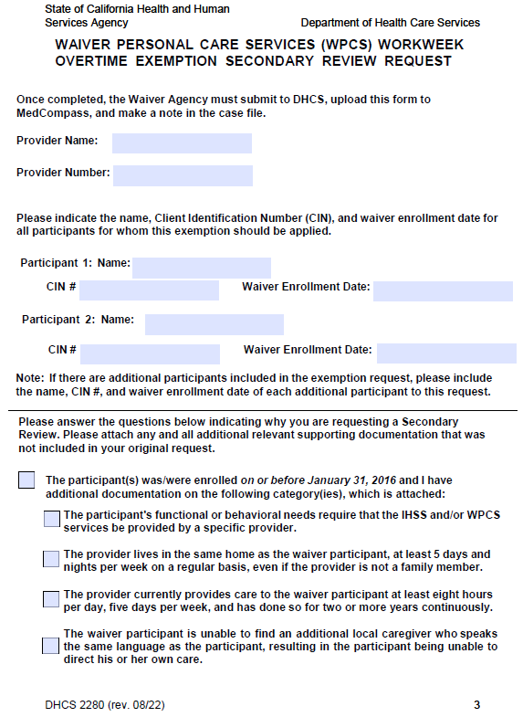

Page 3 of 5
DHCS 2280

Slide 35
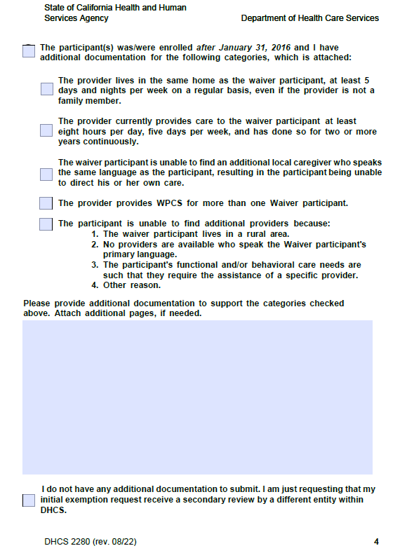

Page 4 of 5
DHCS 2280

Slide 36
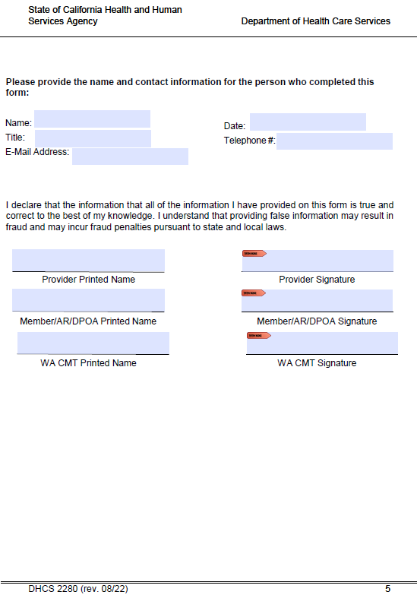
Page 5 of 5
DHCS 2280

Slide 37

Submitting OT Exemption Requests
The WA must submit the initial OT Exemption form (DHCS 2279) to DHCS.
The Provider/Participant can mail the Secondary Review Requests form (DHCS 2280) themselves or the WA can submit on their behalf (preferred).
Both forms should be submitted via mail or email (preferred) to DHCS at:
CareManagement@dhcs.ca.gov

Slide 38
Important Links
DHCS 2279: Waiver Personal Care Services (WPCS) Workweek Overtime Exemption Request Form
DHCS 2280: Waiver Personal Care Services (WPCS) Workweek Overtime Exemption Secondary Review Request Form
Policy Letter No. 22-001: Waiver Personal Care Services (WPCS) Workweek Overtime Exemption Request and Secondary Review Process

Slide 39


Questions?
Call the WPCS Hotline at
(916) 552-9214
or send an email to CareManagement@dhcs.ca.gov

