Slide 1
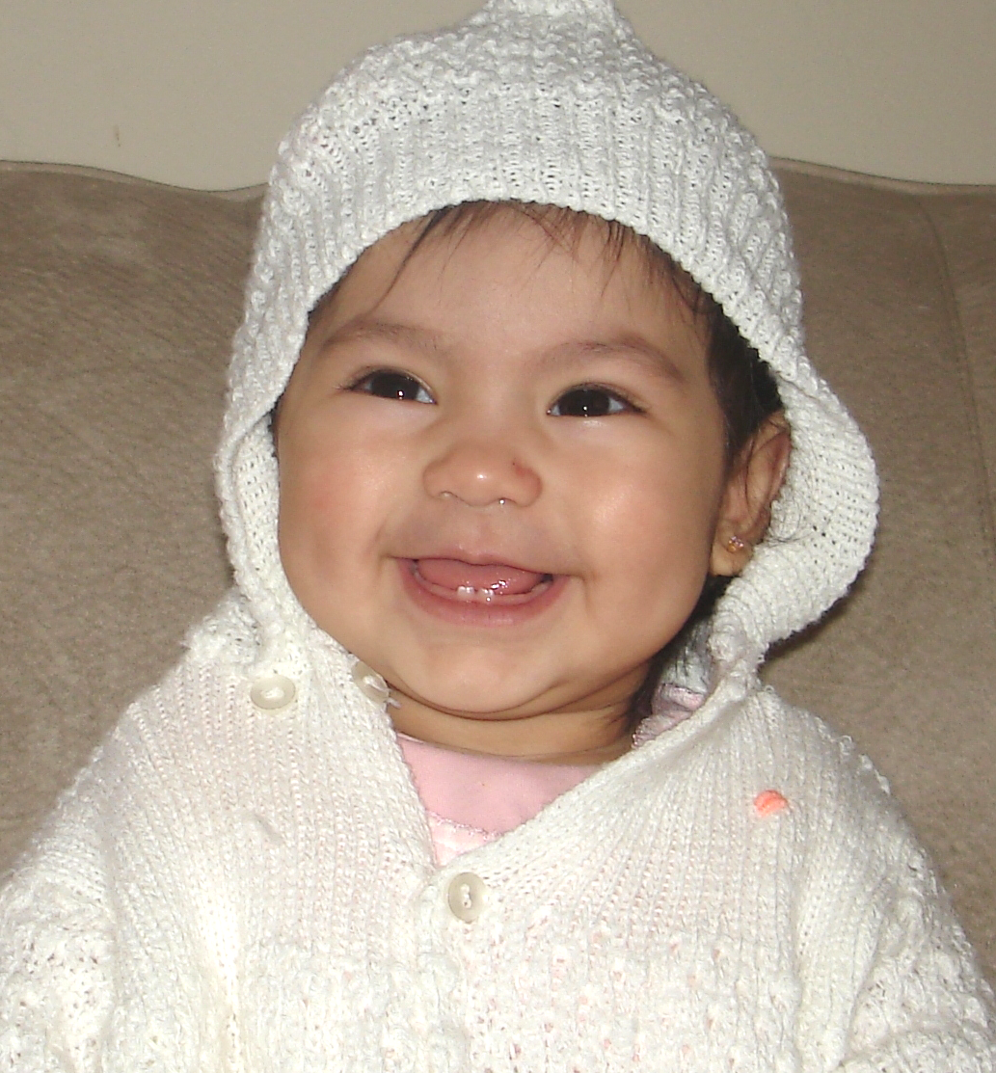
CHDP Dental Training:
Oral Health Assessment and Referral
California Child Health & Disability Prevention (CHDP) Program Statewide Dental Subcommittee
Adapted from:
CHDP Program - Health Assessment Guidelines and Provider Manual
and American Academy of Pediatrics (AAP) Oral Health Initiative
December 2011
http://www.dhcs.ca.gov/services/chdp/Pages/CHDPDentalTraining.aspx
Notes:
Preparation for this Presentation:
Review all slides and links including videos for background information.
Consider printing power point (PPT) 3-6 slides per page for each participant.
If internet access is available and time permits, open links on slides to show providers during the presentation.
Speaker Tip:
Describe contents of training packet.
Talking Points:
The information provided in this training is based on the California CHDP Health Assessment Guidelines and Provider Manual, and the most current AAP oral health policy and is also referenced throughout with studies and reports from organizations such as CDC, California Dental Association, and the Pew Center, among others.
At the end of this presentation there will be short review questions and a brief evaluation of this training to help us improve it.
We encourage you to visit the State CHDP website training page (Link on bottom of this slide) and explore helpful links and references found throughout this presentation.

Slide 2
Problem Statement
Low income children are at highest risk for dental caries
http://cdhp.org/resource/gao_report_dental_disease_chronic_problem_among_low_income_populations
Over 70% of California children have a history of dental caries by grade 3 (2006)
  http://www.centerfororalhealth.org/images/lib_PDF/dhf_2006_report.pdf
Dental caries is historically the most frequently reported problem of CHDP children
  Nearly 75% of CHDP Dental Assessments were incorrectly documented on the PM160 – resulting in children not being referred to a dentist *
*Survey of 7 Counties, California Child Health and Disability Prevention (CHDP) Program, 2008
Notes:
Talking Points:
(First bullet)
All CHDP Children are of low Socio Economic Standing (SES) and should be considered “High Risk”.
(Third bullet)
In 2008, seven counties in the Bay Area surveyed PM160 forms and found the majority were not filled out completely.
Key information was not provided; “Dental Assessment” was checked but:
If problem was detected ~ dental referral information and comments section was incomplete or blank.
If no problem was detected ~ routine dental referral was not checked.

Slide 3
AAP Policy
AAP Children's Oral Health
To encourage and support child health
care providers to conduct oral health risk assessment and provide education and preventive oral health services to families within the context of well child care; and to promote the establishment of a dental home.
  http://www2.aap.org/oralhealth/
Notes:
Talking Points:
American Academy of Pediatrics (AAP) considers oral health an important part of a child’s overall health. They have a dedicated webpage, trainings and policy statements addressing children’s oral health.

Slide 4
Training Objectives
Perform a complete dental assessment at every CHDP Health Assessment regardless of age
Document correctly on PM160 form suspected problems or routine dental referral
Refer all children age one and over at least annually to a dentist at the time of their CHDP Health Assessment, and more frequently if a problem is detected or suspected
Provide anticipatory guidance and encourage establishment of a “Dental Home” for child/family
Apply fluoride varnish to prevent, arrest, or delay the onset of caries
Notes:
Talking Points:
By the end of this training session, you will be able to…
(Review slide bullets with providers)
Health care providers are the gateway to oral health, as they have multiple opportunities to influence the need for early dental care. For example, in the first twelve months of life the CHDP child receives 6 well child exams.

Slide 5
4 Steps
Acceptable Dental Assessment and Referral
Based on the CHDP Provider Manual
      Risk Assessment
      Oral Assessment
      Documentation on PM160 form
      Referral to a Dental Provider

Slide 6

Step 1: Risk Assessment
All CHDP and low-income children are considered at risk for dental caries.

Slide 7
Additional Caries Risk Factors
Active or Past
Tooth Decay
  – In poor oral habits can be passed on to children, and/or parents can transmit decay causing bacteria to their child
  White spot lesions on teeth
Poor Feeding Habits
  Frequent snacking on carbohydrates
  Sticky sugary foods
  Sweet/acidic drinks
  Bottle in bed
  Bottle after age 1
Lack of Fluoride in
  Drinking water
  Vitamins/Supplements
  Toothpaste
No Recent Dental Visit
  Within the last year
Poor Homecare
  – Lack of daily brushing
  and flossing
Children with Special Needs
Notes:
Preparation:
Identify if local water is fluoridated (access the CDPH link on slide #11)
Talking Points: This is information that you will need to discuss with parents.
Active or Past Tooth Decay:
Poor oral habits can be passed on to children, or parents can transmit dental causing bacteria to their child.
Poor Feeding Habits:
Bacteria live in sticky plaque attached to surface of the teeth, and any sugary food like milk, juice, cookies, crackers, feeds the bacteria making acid. Acid destroys the tooth.
Sleeping with bottle ~ Baby doesn’t completely swallow all the liquid. Sugary drinks and milk can pool around teeth. Anything other than water can cause a problem.
Lack of Fluoride:
Know your patients’ fluoride exposure ~ Fluoride in community tap water vs. use of bottled water? (See additional information on slide #10)
Children with Special Needs:
Inability to cooperate
Lack of motor skills
Lack of access to specialized dental care
Medication side effects :
reduced saliva
sugar based
tissue changes including gum overgrowth, and sensitive, red tissue

Slide 8
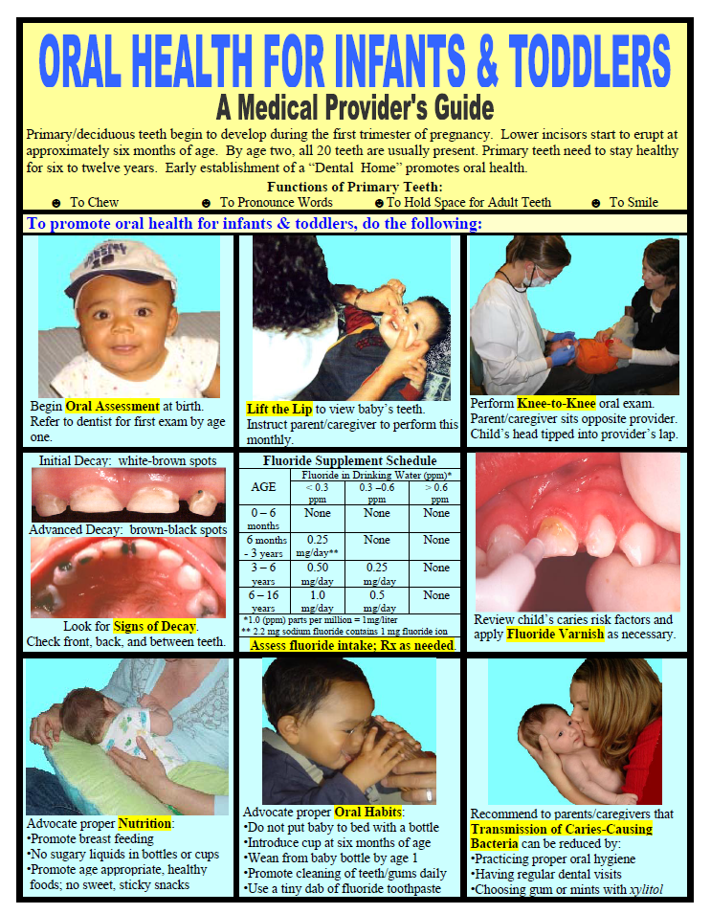
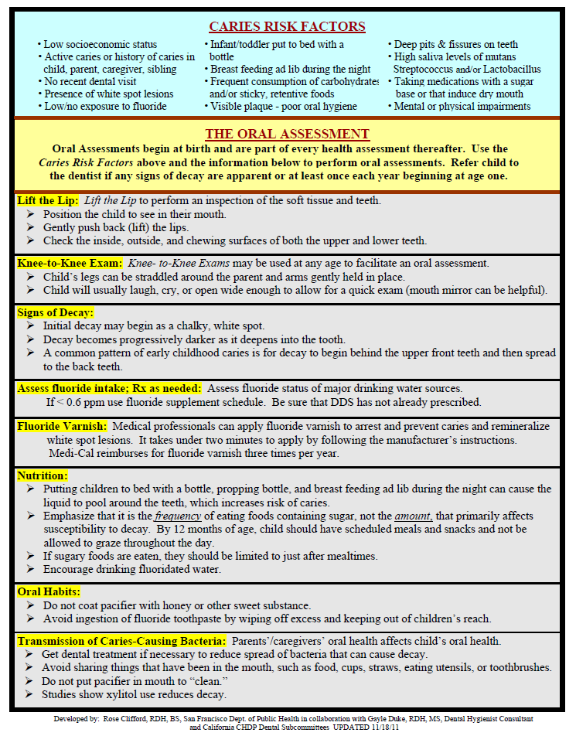
CHDP Provider’s Guide
Print copies of the Guide for your exam room:
http://www.cdph.ca.gov/programs/MCAHOralHealth/Documents/MO-OHP-OralHealthInfantToddler.pdf
Notes:
Preparation:
Print double sided and laminate (or put in clear document protector) sample(s) of guide to show providers.
Talking Points:
(Advise providers to) Print this guide and place in a document protector or laminate for the exam room.
This can be used as a reference and a visual tool to educate parents/caregivers.

Slide 9

Risk Assessment
For more information:
AAP Oral Health Risk Assessment Tool:
Tutorial and Download
Online at: http://www2.aap.org/commpeds/dochs/oralhealth/RiskAssessmentTool.html
Bright Futures in Practice: Oral Health
Dental Caries Risk Assessment Table
Online at: http://www.mchoralhealth.org/pocketguide/tables1.html
Featherstone et al. Caries Management by Risk Assessment: Consensus Statement April 2002. Journal CDA 2003 31(3): p. 257-269
Online at: http://www.cda.org/library/cda_member/pubs/journal/jour0303/consensus.htm
Notes:
Talking Points:
We encourage you to explore these links to help you learn and integrate oral health risk assessment into your practice.

Slide 10
Fluoride Assessment
Ensure only one systemic fluoride:
          Tap water if fluoridated
          or
          • Well water (test for fluoride level)*
          or
          • Bottled water with added fluoride
          or
          • Fluoride supplements Rx from medical
          or dental office
And
Encourage all topical fluorides:
Toothpaste, rinses, treatment in a dental or medical office, fluoride varnish in a school, childcare or other community setting
*www.swrcb.ca.gov/water_issues/programs/gama/domestic_wells_testing.shtml
*www.cdc.gov/fluoridation/fact_sheets/wellwater.htm
Notes:
Speaker Tips:
Call your county water resource agency to check which areas in your community are fluoridated. See 2nd link on next slide for site to check fluoridation status.
For communities which use well water, click on links at bottom of slide for more information.
In case of questions about too much fluoride (Fluorosis):
Fluorosis is the discoloration of teeth caused by excess ingestion of fluoride.
Fluorosis is not usually an issue for the CHDP population. For more information click on 1st link on next page.
Talking Points:
Even if a child is taking a systemic fluoride, the use of topical fluorides is still recommended.
Make sure that the child is getting only ONE systemic fluoride.
Fluoride re-mineralizes the enamel of teeth and can inhibit the ability of bacteria to produce acid, by blocking bacterial enzymes.
Fluoride is an easy and cheap way to prevent and arrest tooth decay.
Fluoride is needed regularly throughout life to protect teeth against tooth decay.
Read More:
http://www.ilikemyteeth.org/fluoridation/

Slide 11
Fluoride Supplementation
Prescribe a supplement according to CDC guidelines:
www.cdc.gov/mmwr/preview/mmwrhtml/rr5014a1.htm#tab1
California – Fluoride Levels in Public Drinking Water:
www.cdph.ca.gov/certlic/drinkingwater/Documents/Fluoridation/PWS%20Statewide%20Fluoridation%20Table%202010.pdf
Fluoride concentration in drinking water (ppm*)
Age | less than 0.3 ppm | 0.3 - 0.6 ppm | greater than 0.6 ppm
Birth - 6 months | None | None | None
6 months - 3 years | 0.25 mg/day** | None | None
3 - 6 years | 0.50 mg/day | 0.25 mg/day | None
6 - 16 years | 1.0 mg/day | 0.50 mg/day | None
* 1.0 parts per million (ppm) = 1mg/L
Notes:
Talking points:
Fluoride supplementation is prescribed to a child in drops or tablets and taken daily age 6 months to 16 years.
Water fluoridation optimizes the public water system with a level of 0.7ppm of Fluoride. If unknown whether local water is fluoridated, check web site on bottom of this slide.
If water is fluoridated, then fluoride supplementation should not be prescribed.
Filtered tap water and bottled water may not contain fluoride. Reverse Osmosis filters remove fluoride from tap water. Charcoal filters such as Britta and Pur generally do not remove fluoride.

Slide 12
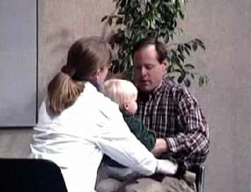
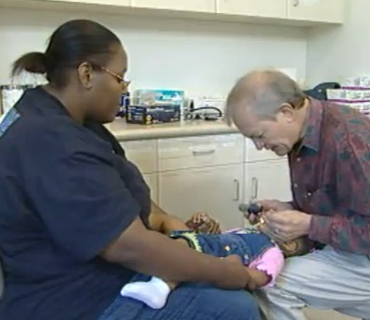
Step 2: Oral Assessment
Perform an inspection of the mouth, teeth, and gums at each health assessment visit (Required by CHDP*)
Sample oral health assessments:
    Smiles for Life First Five Oral Health
    http://www.youtube.com/user/aaptv#p/search/1/Hw99Aoti7ZE http://www.youtube.com/watch?v=UF4Ra1ZgovI
* California Code of Regulations Title 17 Section 6843 “An inspection of the teeth, gums and mouth is part of the health assessment.”
Notes:
Talking Points:
Each of these videos presents a demonstration of “knee to knee” exam and oral health assessment.
This exam can be also be performed on the exam table.

Slide 13

Dental Section of CHDP
Health Assessment Guidelines (HAG)
Materials adapted from
Bright Futures in Practice: Oral Health http://www.mchoralhealth.org/pocketguide/index.html
Includes developmental stages
What to expect
Provides anticipatory guidance
Age specific information
View CHDP Health Assessment Guidelines:
www.dhcs.ca.gov/services/chdp/Pages/Pub156.aspx
Notes:
Talking Points:
CHDP Health Assessment Guidelines include a dental section with information on oral health topics, anticipatory guidance by age, and other resource links.
These guidelines are to be used by providers to help incorporate oral health into their practice.

Slide 14
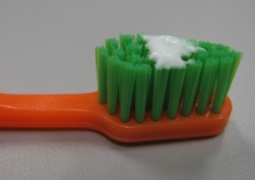
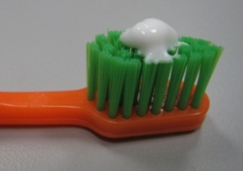
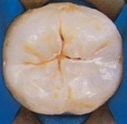
Provide Anticipatory Guidance
Oral health messages to parents*
  Establish a “Dental Home”
  No bottle in bed with baby
  Brush at least twice a day
  Use a small amount of toothpaste with fluoride
  www.mchoralhealth.org/PediatricOH/mod4_2_3.htm
    Toothpaste should not be swallowed
    Use the size of a grain of rice (dab) until child is able to spit
    Use a “pea size” for all others
  Ask dentist about sealants
http://www.cdc.gov/OralHealth/publications/factsheets/sealants_faq.htm
    Protects pits and grooves
    from decay
  Size of a grain of rice (dab) until child can spit
  “Pea size” for
  all others
Before
After
*Caries Risk Assessment Appropriate for the Age 1 Visit, Ramos-Gomez
http://www.dhcs.ca.gov/services/chdp/Documents/CHDPDental/RiskAssessment.pdf
Notes:
Speakers Tip:
A “dental home” will be discussed in more detail on slide #36.
Talking Points:
A “dental home” is a clinic or office where a child/family receives routine dental care on a regular basis.
Toothpaste advertisements often show too much toothpaste applied to the brush. In reality, you only need a very small amount (adults as well).
Sealants are thin resin coatings placed in pits and grooves of chewing surfaces of back teeth to prevent tooth decay.
Sealants generally last 5 -10 years and are applied only by dental professionals.
Sealants are a benefit of Denti-Cal, Healthy Families and most dental insurance.

Slide 15

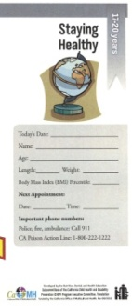



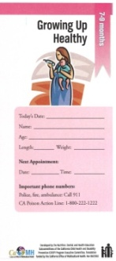
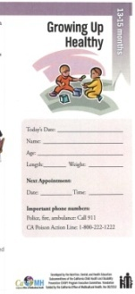
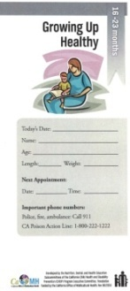
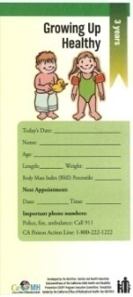

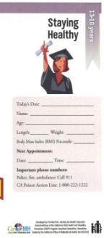
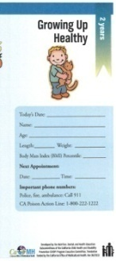
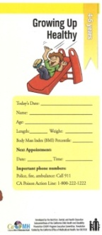

Provide Anticipatory Guidance
CHDP Growing Up Healthy brochures
14 age-specific educational brochures for families
Topics include:
  Health
  What to Expect
  Safety
  Dental
  Nutrition
Print copies of CHDP Growing Up Healthy brochure:
English, Spanish, Chinese, Vietnamese
Notes:
Preparation:
Speaker may want to print a sample brochure to share with providers.
Talking Points:
These are available in multiple languages .

Slide 16
Step 3: Documentation on PM160 Form
Reasons to Document:
Identifies children that need care coordination to access dental services
Fulfills Federal EPSDT mandates and reduces risk of State and Federal audits
Data reported may increase funding
Strengthens overall CHDP program
Notes:
Talking Points:
A dental assessment is not complete until it is properly documented on the PM160 form.
EPSDT is Early and Periodic Screening, Diagnosis, and Treatment.
Reported data may serve as a base for private and public funding. A FQHC’s encounter rate is linked to the federal mandate to properly document and report.
Case management of children with active disease improves overall health outcomes.

Slide 17
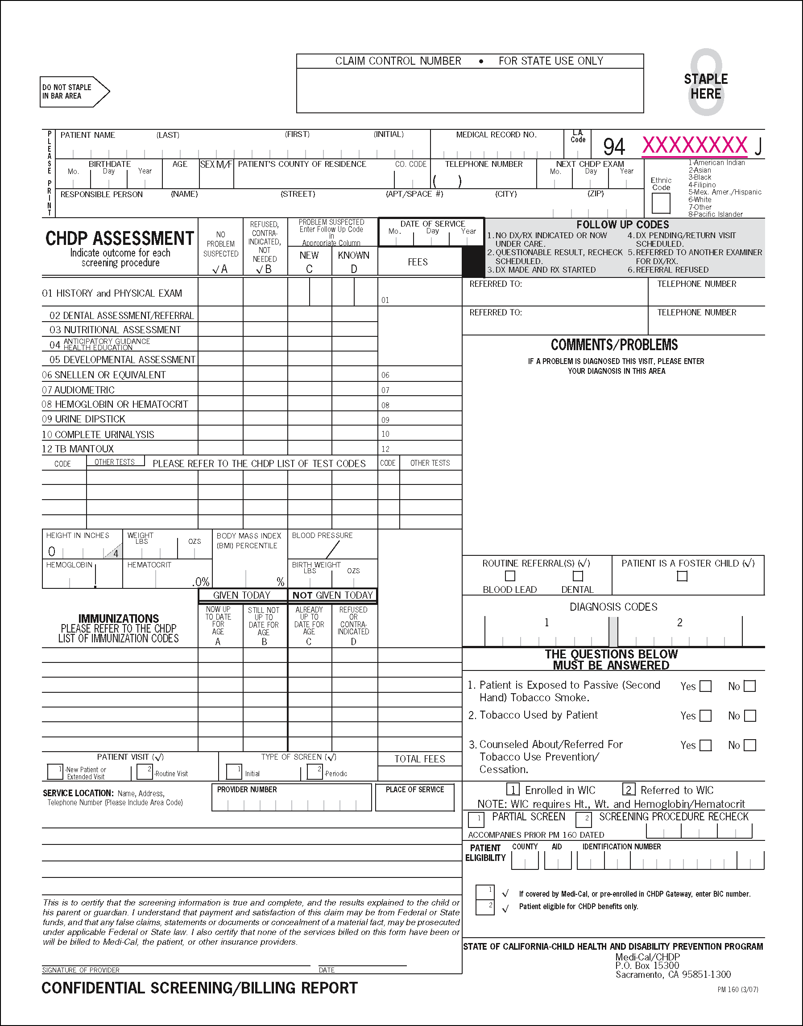
4 Dental Areas to Document
Confidential Screening/Billing Report*
02 Dental Assessment/Referral
Comments/Problems
Referred To
Routine Referral Dental
02 DENTAL ASSESSMENT/REFFERRAL
* PM160
Notes:
Preparation:
Bring at least one original PM160 form, and copies for participants.
Talking Points:
The four yellow highlighted sections relate to the dental assessment.
Provider is required to give copy of PM160 form to parent.

Slide 18
Dental Assessment
02 Dental Assessment/Referral –
Document in column A, B, C or D according to findings
Notes:
Speaker Tips:
Review briefly each specific section of the Dental Assessment in the following 4 slides.
Talking Points:
(Ask participants to) Locate the 02 Dental section on their copy of the PM160 form.
Column A “No Problem Suspected” If this box is checked, then provider must also check the “Routine Referral Dental” box located under the .
Column B “Refused, Contraindicated, Not Needed” should never be used for dental, unless parent/child refuses. Document reason in “Comments/Problems” box.
Column C “Problem Suspected – New” (if not known to family) Use only follow up codes 1-6.
Column D “Problem Suspected – Known” (if previously identified and/or family is aware of the problem) Use only follow up codes 1-6.

Slide 19
Dental Assessment2
Comments/Problems –
Describe the condition and classify using Class I, II, III or IV
(Examples of classifications to follow)
Notes:
Speaker Tip:
Stress the importance of adequately documenting problems in the comments section.
Talking Points:
It is essential to document detailed comments to ensure adequate and appropriate care coordination.
Write the dental decay classification AND briefly describe the problem in the comments section.
Discussion on classifications will follow on slides #22 - 32.

Slide 20
Dental Assessment3
Referred To –
Enter one of the following:
  Dentist name/phone
  CHDP dental list
  Local county helpline
  Denti-Cal 1-800-322-6384
Notes:
Preparation:
Learn what dental provider resources are available and best used in your county. Check the Denti-Cal Website for a list of dentists (Slide #62 ).
Bring an updated list of dentists in your county/local community to this training.
Talking Points:
Direct office to ask family if they have a dental home. If not, give them the CHDP dental list, local county helpline or Denti-Cal number.
Provider should enter the name and telephone number of the dental provider in the designated REFFERRED TO area, so that family can make an appointment, or local CHDP staff can help coordinate care and ensure timely dental care.

Slide 21
Dental Assessment4
Routine Referral
Dental Box –
Always mark if column A is checked for ages one and older
Notes:
Talking Points:
If no dental problem is found during the assessment, check column A or B and enter a check mark (√) in the routine dental referral box, (where the red arrow is pointing).
Ask parent if their child has been to the dentist in the past 6 months, if not tell the family to take them to their dentist. Provide the family with a list of dentists in their zip code, or telephone “help-line” number in their local area, if they don’t have a dentist.

Slide 22
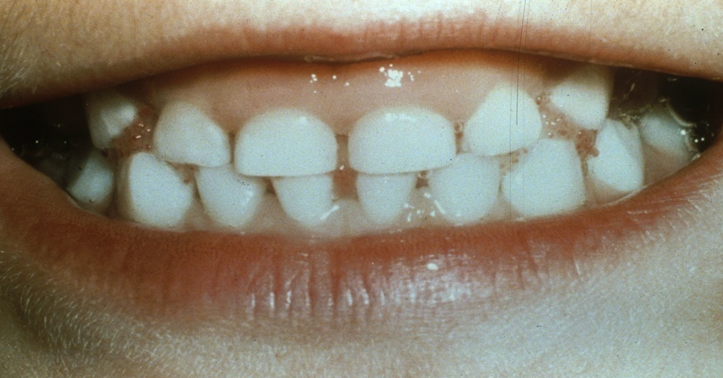
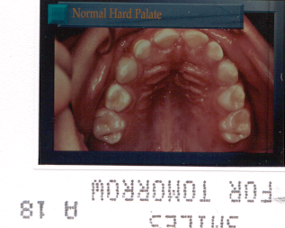
Dental Treatment Class I
No visible decay, inflammation or oral problems
Refer to dentist for routine dental care
(Children with full Medi-Cal are covered through Denti-Cal for routine care every 6 months)
Notes:
Talking Points:
(Evaluate the amount of oral health knowledge of attendees.) Ask how familiar they are with dental conditions?
There are four dental classifications of treatment needs ranging from no visible problems to emergency care.
During the Dental Assessment the Provider should:
Use a tongue depressor and/or gloved fingers for better visibility.
Lift the upper lip and pull down the lower lip away from the teeth to see the entire gum area.
Look at upper and lower teeth, inside (lingual) and outside (facial) and biting surfaces of all teeth and gums.

Slide 23
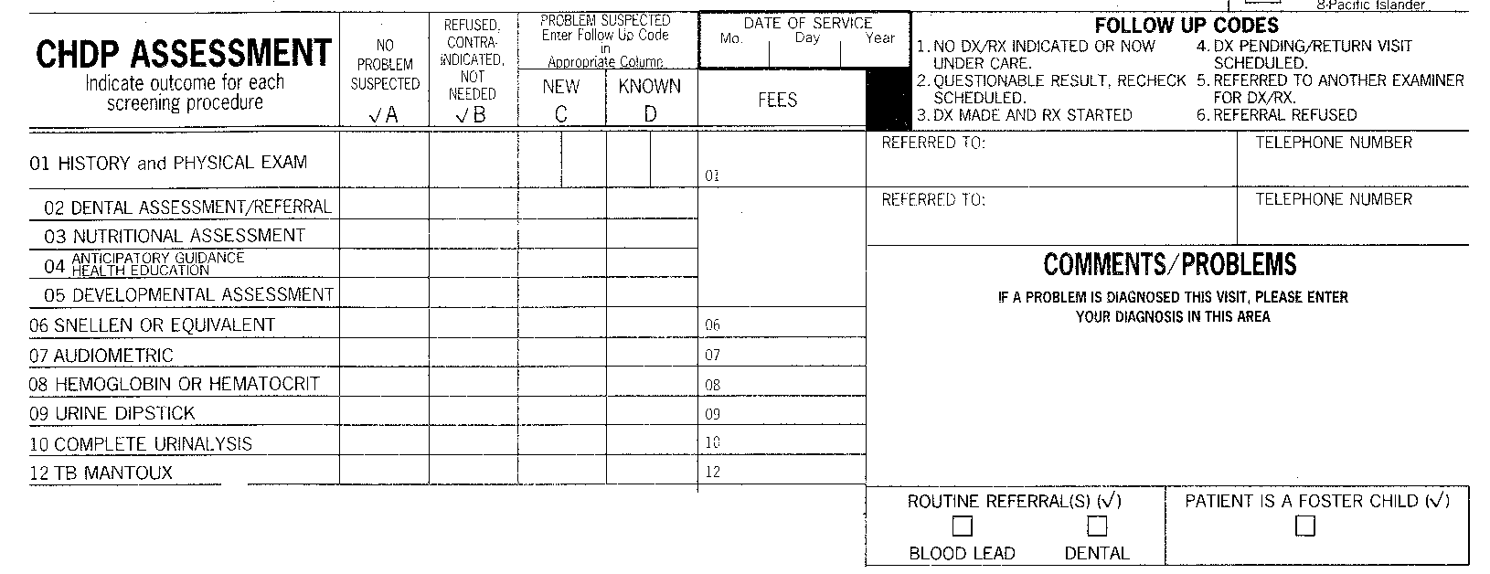
How to Document Class I
No Problem Suspected - Check column A
Routine Referral - Check dental box
Refer at Least Annually - Beginning at age one
REFERRED TO: TELEPHONE NUMBER:
02 DENTAL ASSESSMENT/REFERRAL
☑
ROUTINE REFERRAL(S) (☑ )
☑
DENTAL
Notes:
Speaker Tips:
Direct providers to look at PM160 sample form in the areas highlighted.
Talking Points:
For class I, even though no problem is suspected, remember to always check routine dental referral box, and advise parents to take their child to a dentist every six months.

Slide 24
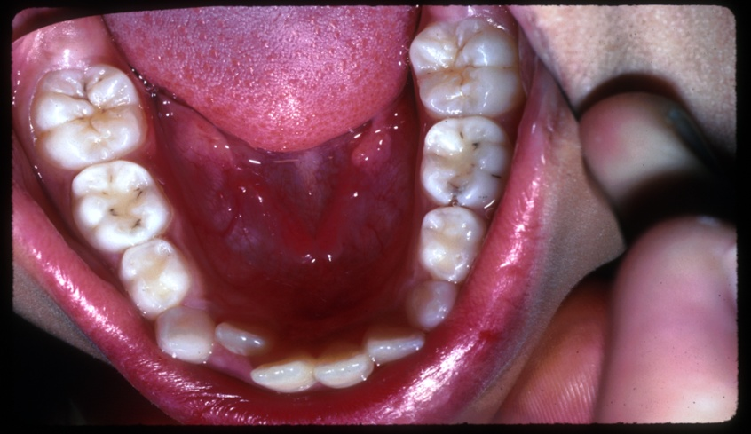
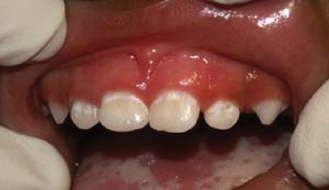
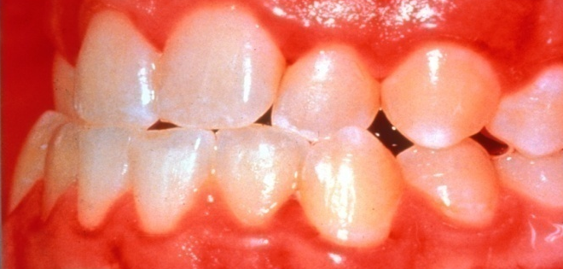
Dental Treatment Class II
Mild Dental Problems - Small carious lesions (including decalcifications) and/or mild gingivitis
Condition is Not Urgent - Requires a dental referral
Beginning Decay
(white chalky decalcification near gum line)
Small Carious Lesions
Mild Gingivitis
(slightly red and swollen gums)
Notes:
Talking Points:
Class II conditions can easily be missed if not examined closely. If there is any uncertainty, classify as a II. All of these conditions will progress if left untreated.
Early decalcification may look like a white line on the tooth, next to the gums. This is an early stage of decay, but if treated promptly, can be reversed and/or stopped. Refer to a dentist.

Slide 25
How to Document Class II
Enter Follow-up Code 5 - in column C if new problem, or in column D if known problem
Describe Problem - in comments section
Enter Name/Telephone of Dentist - in “REFERRED TO:” box
REFERRED TO: TELEPHONE NUMBER:
02 DENTAL ASSESSMENT/REFERRAL
5
02 - Class II - gingivitis and tooth decay (5)
Notes:
Speaker Tips:
Review the key bullets on slide, directing participants’ attention to highlighted areas.
Talking Points:
As shown in the comments/problems section, this is the minimum that should be written.
If possible be more descriptive and this will help with care coordination. For example: “white line decay ”, “inflamed gums” or “dark pits/grooves on teeth” would be something else that could be written.

Slide 26
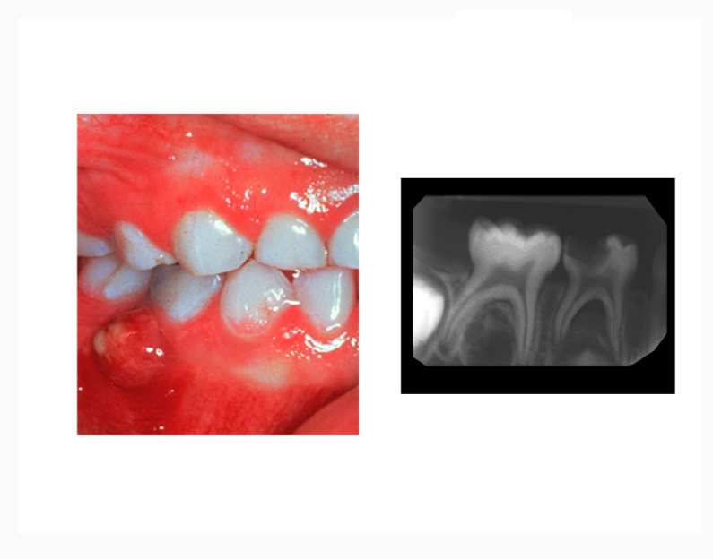
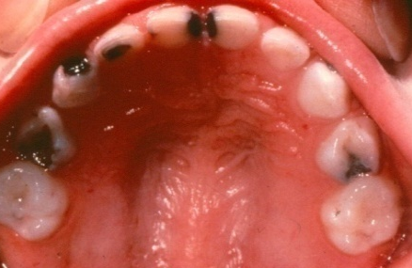
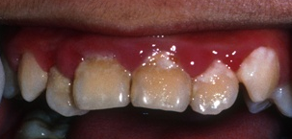
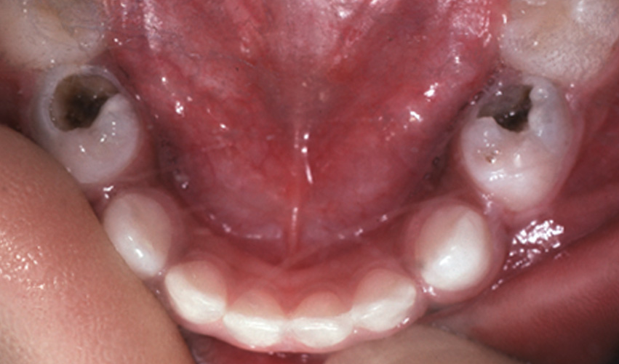
Dental Treatment Class III
Severe Dental Problems – Large carious lesions, abscess, extensive gingivitis, a history of pain, or severe (medically handicapping) malocclusion
Need for Dental Care is Urgent – Conditions can progress rapidly to an emergency. Make dental appointment today!
Abscess
(See dentist without delay!)
Large Carious Lesions
Extensive
Gingivitis (red, swollen, infected, inflamed gums)
Early Childhood Caries (ECC)
Notes:
Talking Points:
If any of these conditions are found, complete column C or D and describe problem in the comments box.
If there is an abscess, decay may not always be visible on the tooth, be sure to pull lip/cheek back to look for evidence of an abscess (swelling of gum, or pimple/”fistula”).
Document and refer.

Slide 27
How to Document Class III
Enter Follow-up Code 5 - in column C if new problem, or in column D if known problem
Describe Problem - in comments section
Enter Name/Telephone of Dentist - in “REFERRED TO:” box
REFERRED TO: TELEPHONE NUMBER:
02 DENTAL ASSESSMENT/REFERRAL
5
02 - Class III - Early Childhood Caries, ECC (5)
Notes:
Speaker Tips:
Review the key bullets on slide directing participants’ attention to highlighted areas.
Talking Points:
Ask providers: “What should you write in the comments box for a Class III?”
Answer:
Always write 02 - This indicates the area of concern is “Dental”.
Classification: Class III
Findings: Specific problem, i.e., Early Childhood Caries (ECC )
Follow-up code: Referrals will noted as a (5)

Slide 28
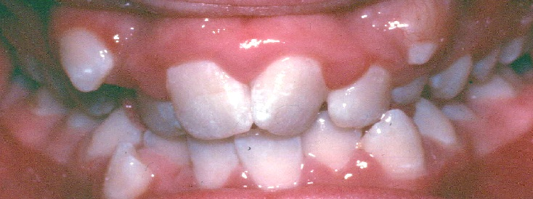
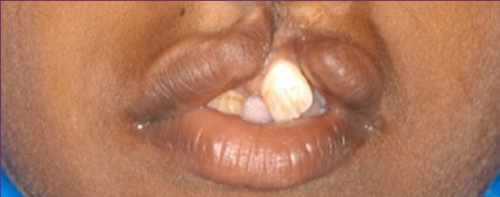
Limited Orthodontics and Craniofacial Care through CCS and Medi-Cal
Severe Medically Handicapping Malocclusions - Children with all permanent teeth present or age
13 through 20
Cleft Lip/Palates and Other Craniofacial Anomalies - Children age 0 through 20
Notes:
Preparation:
Have at least one copy available of the Orthodontic Guide (found on slide #29) to show participants.
Talking Points:
Orthodontic coverage through California Children’s Services (CCS) and Medi-Cal is not for cosmetic conditions. Teeth must be severely twisted, overlapped, protruded or misaligned causing functional problems.
Cleft palate and craniofacial anomalies, severe abnormalities of the mouth, jaw and/or teeth, may result from trauma, genetics or other gross facial pathology.
These conditions which require further specialized treatment may be eligible for CCS coverage in your county.

Slide 29
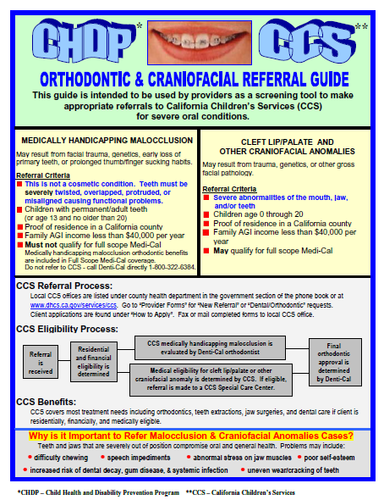
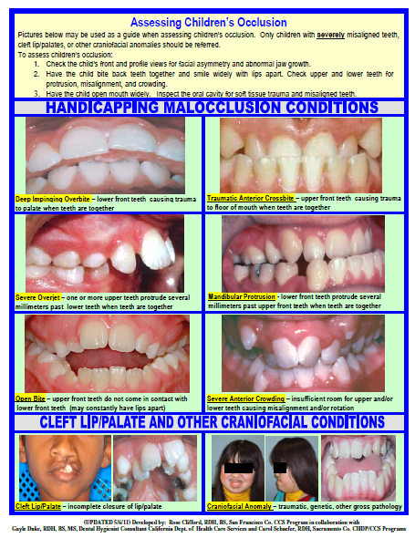
CHDP/CCS* Orthodontic & Craniofacial
Referral Guide
*
California Children’s Services (CCS)
http://www.dhcs.ca.gov/services/ccs
Scroll to “Contact a CCS Program” for list of local county offices.
Print copies of this guide for your exam rooms:
http://www.cdph.ca.gov/programs/MCAHOralHealth/Documents/MO-OHP-OrthodonticCraniofacialReferralGuide.pdf
Notes:
Preparation:
Print double sided and laminate (or put in clear document protector) sample(s) of guide to show providers.
Talking Points:
(Advise providers to) Print this guide and place in a document protector or laminate for their exam rooms.
This can be used as a reference and a visual tool to educate parents/caregivers.
Familiarize yourself with this guide which has examples of severe conditions that should be referred.

Slide 30
How to Document Orthodontics and Craniofacial Anomalies
Enter Follow-up Code 5 - in column C if new, or column D if known
Describe Problem - in comments section as Handicapping Malocclusion or Craniofacial Anomaly
Enter Name/Telephone Number of Dentist - or Denti-Cal orthodontist in “REFERRED TO:” box
REFERRED TO: TELEPHONE NUMBER:
02 DENTAL ASSESSMENT/REFERRAL
5
02 - Class III - Handicapping Malocclusion (5)
Notes:
Talking Points:
Document on PM160 as instructed on the slide.
In addition to filling out the PM160 form, providers should refer:
For possible craniofacial anomalies contact local county CCS (link on guide)
For severe handicapping malocclusion:
If child has Full Scope Medi-Cal, refer to Denti-Cal (1-800-322-6384).
For others: such as: Healthy Families, Healthy Kids, Share of Cost /Emergency Only Medi-Cal, and other low income children, contact local county CCS (link found on slide # 29).

Slide 31
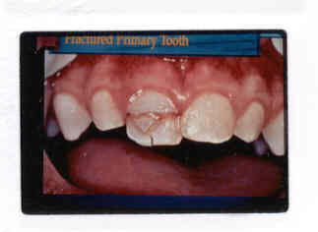
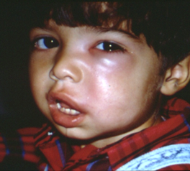
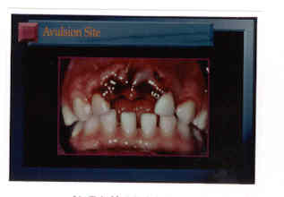
Dental Treatment Class IV
Emergency Dental Treatment Required - Acute injury, oral infection, or pain
See Dentist Immediately - or at least within 24 hours
Acute Injuries
Oral Infection/Cellulitis
For more information: Acute Dental Emergencies In Emergency Medicine
Webmaster to upload pdf to CHDP training site
Notes:
Preparation:
Speaker should review link for “Acute Dental Emergencies in Emergency Medicine” at bottom of slide.
Talking Points:
Child needs to be seen by a dentist immediately in all cases.
Top photo: Tooth is fractured and may involve the “nerve” of the tooth.
Bottom left photo: Tooth may have been shoved up into gums or knocked out (avulsed).
Right hand photo: Before oral assessment, look at the whole face to check facial symmetry and swelling (which could be subtle), as this may indicate infection/abscess.
Assess need for antibiotics.
For oral infections, if antibiotics are prescribed, emphasize to parents that antibiotics alone may not remove underlying dental cause and infection can recur.
Child needs to see dentist immediately.

Slide 32
How to Document Class IV
Enter Follow-up Code 5 - in column C if new, or column D if known
Describe Problem - in comments section
Enter Name/Telephone Number of Dentist - in
“REFERRED TO” box
REFERRED TO: TELEPHONE NUMBER:
02 DENTAL ASSESSMENT/REFERRAL
5
02 - Class IV - Emergency, Oral Infection (5)
Notes:
Speaker Tips:
Review the key bullets on slide directing participants’ attention to highlighted areas.
Talking Points:
Include a description of the emergency on PM160 form: i.e., broken tooth, location of swelling, avulsed tooth, etc.
In addition to documenting on the PM 160:
It is the provider’s duty to make sure the parent understands that this is an emergency, and requires immediate attention by a dentist to treat the underlying cause.
Stress that: Oral infections can lead quickly to serious systemic complications.
Assist the family to schedule a dental appointment.
It is advised that your medical office follow up with parents.

Slide 33
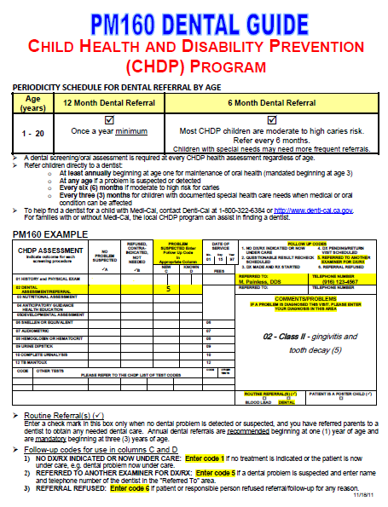
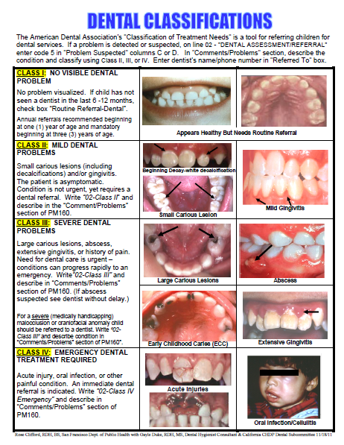
PM 160 Dental Guide
Print copies of this guide for your exam rooms:
www.dhcs.ca.gov/formsandpubs/publications/Documents/CMS/pm160dentalguide.pdf
Notes:
Preparation:
Print double sided and laminate (or put in clear document protector) sample(s) of guide to show providers.
Talking Points:
(Advise providers) Print this guide and place in a document protector or laminate for your exam room.
This can be used as a reference and a visual tool to educate parents/caregivers.
This guide includes:
Periodicity schedule for dental referral
How to document on the PM160 reporting form
Provides visual reference for the classifications of dental needs

Slide 34
Step 4 - Referral to a Dental Provider
Routine Referral
  Annually beginning at age one
  Semi-annually for moderate to high risk children
  (a Medi-Cal/Denti-Cal benefit once in a six month period)
  Children with special needs may require more frequent referrals
  OR
Refer if a problem is detected or suspected at any time regardless of age
Notes:
Talking Points:
You have learned the first 3 steps for a CHDP dental assessment:
Risk Assessment
Oral Assessment
Documenting on PM 160 reporting form
To complete the dental assessment you must include Step 4 ~ the dental referral.
At a minimum, an annual referral is required.
CHDP children are considered moderate to high risk and should be referred every six months.
Children with special needs:
May require more frequent dental visits due to increased risk of gum disease and dental decay. Problems include: high carbohydrate diet, lack of dexterity, cooperation challenges, medication side effects (dry mouth, swollen gums).
Families should be encouraged to discuss their child’s dental care with their dentist.
Medical providers may need to collaborate with dentists, regarding child’s medical condition.

Slide 35
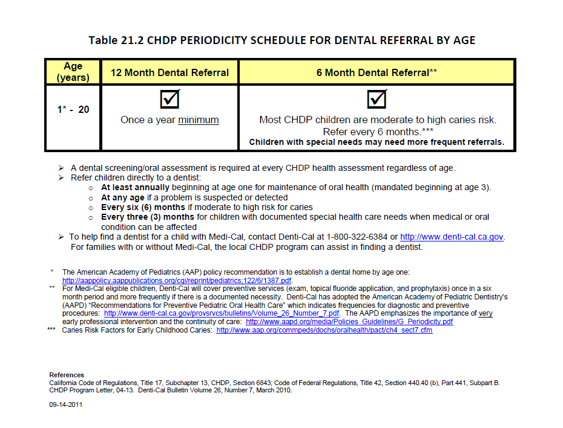
When to Refer
Online at: http://www.dhcs.ca.gov/services/chdp/Documents/Letters/chdppin1110.pdf
Notes:
Preparation:
Review the dental periodicity schedule and links before presentation.
Talking Points:
The website links have great information, including:
AAP Policy recommending “Dental Home” by age one.
Denti-Cal – Finding a local dental provider, and other information.
Be advised that most CHDP children are considered at high risk, and should be referred to a dentist every six months.
A dental referral once a year is the absolute minimum requirement .
Be sure to check the routine dental referral box on the PM16O reporting form.

Slide 36

Promote a “Dental Home”
BROCHURE
Every child needs a
dental home by age one
It is never too late to establish
a dental home
A dental home is a clinic
or office where a child/family receives routine dental care
on a regular basis
AAP Dental Home Policy http://pediatrics.aappublications.org/content/111/5/1113.full.html
Print copies of Every Child Needs a Dental Home brochure:
English, Spanish, Chinese, Hmong, Korean
Notes:
Preparation:
Bring copy or multiple copies of Every Child Needs a Dental Home Brochure (multiple languages available).
Review AAP Dental Home Policy website link.
Talking Points:
Advise parents not to wait until “something hurts” to find a dentist.
Best practices show that the current recommendation for referring a child to the dentist by age one reduces pain, suffering and risk of dental infection, and improves overall health outcomes.
Many parents are not aware of the importance of taking their child early for preventive dental care. It is more effective when this message is conveyed by their physician.

Slide 37
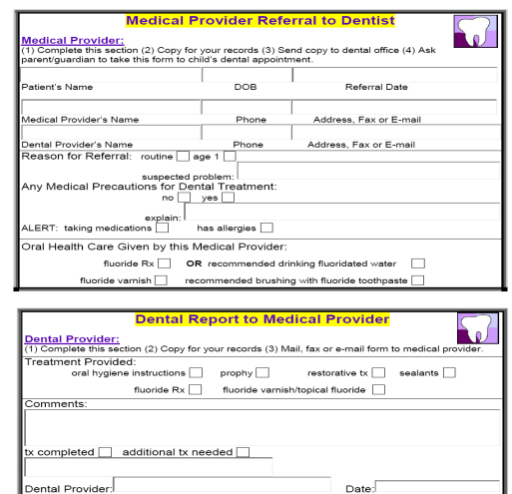
Provider to Provider Communication
Provide written communication
to the dental provider
when possible
    Become familiar with the dental
resources in your community
    Local CHDP dentist list
    Denti-Cal 1-800-322-6384
    Local dental society
    Neighborhood dentists and clinics
    Printable referral form
    Click HERE
    (Link will be hidden.)
Notes:
Preparation:
Bring sample(s) of the form to show providers.
Learn what dental provider resources are available and best used in your county. Check the Denti-Cal Website for a list of dentists (Slide #62).
Bring an updated list of dentists in your county/local community.
Talking Points:
This optional form may be used for communication between the physician and dentist.
Notation of special health care needs or precautions may be beneficial for dental treatment planning.
In addition to the PM160 form that the family receives, this form may provide more detailed communication with the dental provider.

Slide 38
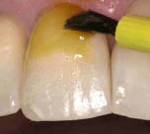
Fluoride Varnish
The CHDP Provider’s Role
Notes:
Preparation:
Review fluoride varnish application videos (Slide #44).
Speaker Tip:
Slides #38-46 can be used as a “stand-alone” fluoride varnish presentation if videos are presented along with the slides.
Talking Points:
Medi-Cal providers can be reimbursed up to 3 times/year for fluoride varnish applications. These applications are in addition to what is provided in a dental office.
Medi-Cal providers now have a responsibility to offer this preventive measure to aid in reducing the incidence of early childhood caries!

Slide 39
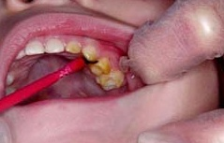
CHDP Providers Prevent Dental Decay
Young children are seen earlier and more frequently by medical providers than by a dentist
Young children are found to have increased prevalence of dental decay
High efficacy of
fluoride varnish
Medical providers are now
placing fluoride varnish to
prevent decay
Notes:
Talking Points:
This is a Medi-Cal benefit for children age 0 through age 5.
This service is covered by Medi-Cal. Billing will be discussed later.

Slide 40
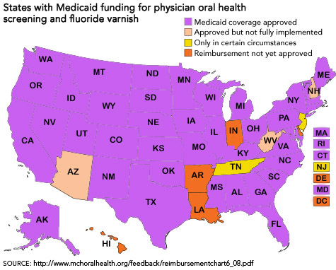
Fluoride Varnish-
Nationwide Effort by Medical Providers
http://www.pewstates.org/research/analysis/reimbursing-physicians-for-fluoride-varnish-85899377335
Notes:
Speaker Tips:
Review Pew Center website.
Talking Points:
We need to applaud the fact that fluoride varnish has been accepted as a Medicaid benefit throughout most of the nation.
The decision to reimburse for fluoride varnish reflects research showing the efficacy of additional applications to reduce dental decay in high risk children.
Medi-Cal providers should either apply fluoride varnish or refer to another Medi-Cal office who does offer this service.

Slide 41
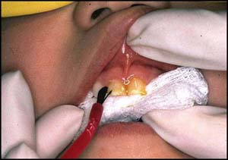
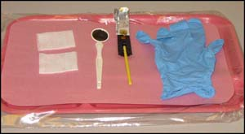
Fluoride Varnish - Facts
A protective resin coating of sodium fluoride
Painted on teeth in ≈ 1 minute
(Crying improves visibility and access)
1 application cuts decay risk
in half www.ncbi.nlm.nih.gov/pmc/articles/PMC2257982/?tool=pubmed
Applied up to 5x per year
  3x in medical office
  2x in dental office
Notes:
Preparation:
If possible bring a sample of fluoride varnish to display and/or samples to share.
Talking Points:
Fluoride varnish is a topical fluoride treatment that prevents new cavities from forming and helps reverse early caries by depositing fluoride onto the tooth to make it stronger.
Even if the child has had a fluoride application at the dental office the day before, this does not contraindicate another fluoride varnish application in the medical office.
For additional information on fluoride varnish we encourage you to do further research. AAP Oral Health Practice Tools: http://www2.aap.org/oralhealth/PracticeTools.html

Slide 42
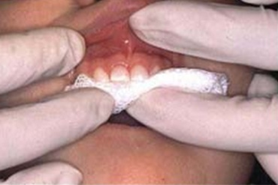
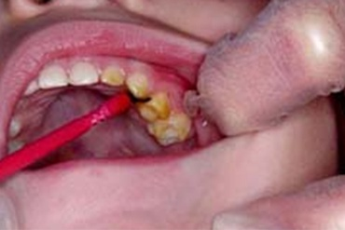
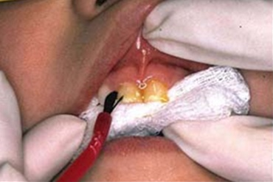
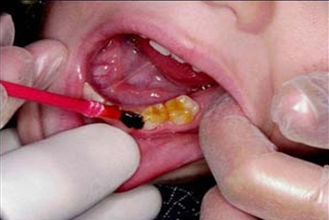
Fluoride Varnish - Application
Notes:
Talking Points:
To apply fluoride varnish:
Apply in sections or quadrants.
Dry teeth with gauze.
Paint fluoride varnish on all tooth surfaces.
If child closes the mouth before varnish is applied to all sections, be sure to re-dry new section before applying varnish.
Varnish immediately sets in contact with saliva.
Fluoride varnish is available in different flavors, and can be clear, white or yellow.

Slide 43
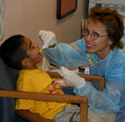
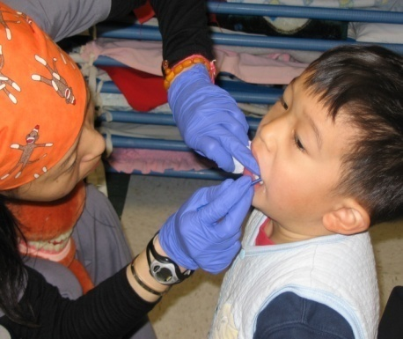
Fluoride Varnish - Who Can Apply?
Medical Office Setting
  MD
  Trained nurses and assistants under MD Rx*
Community Setting**
(School, health fair or government program)
  Any trained person
    With signed parental permission
    Under a doctor’s (or dentist’s) prescription
    Following doctor’s (or dentist’s) protocol
* http://www.dhcs.ca.gov/services/chdp/Documents/Letters/chdppin0608.pdf or http://files.medi-cal.ca.gov/pubsdoco/publications/masters-mtp/part2/dental_m00o03o09.doc
** http://cda.org/popup/cda-sponsored_legislation_clarifies_who_can_place_topical_fluoride_including_fluoride_varnish
Notes:
Preparation Tips:
Review and/or print documents at links noted at bottom of slide.
Talking Points:
Because of the high efficacy of fluoride varnish and the widespread frequency of Early Childhood Caries (ECC) in low income children, fluoride varnish is now being applied in alternative settings, including medical offices and community settings.
As of 2010, a new CA law allows trained individuals to apply fluoride varnish in a public health setting under a dentist’s or physician’s prescription based on either an individual or a population level (e.g., a blanket prescription for all children attending public health events).

Slide 44
Fluoride Varnish - Instructions
Online Videos and Training Modules:
  Smiles for Life - University of Connecticut http://www.youtube.com/watch?v=cV5OmL7C8K4&feature=player_embedded
  American Academy of Pediatrics Television http://www.youtube.com/watch?v=zNOlGS1ggSg&feature=player_embedded
  Maryland’s Mouths Matter
  http://www.ohmdkids.org/flvarnish/
Notes:
Preparation:
Review Training Modules
Speaker’s Tip:
If presenting the fluoride varnish section of the PPT as a separate training, be sure to show at least one of the videos to participants.

Slide 45

Fluoride Varnish - Parent Information
  No water restrictions after application
  Avoid crunchy, chewy or hot foods for the rest of the day
  Do not brush/floss until the next day
  If there is a yellowish coating,
  remove by brushing the next day
BROCHURE
  Print copies of Fluoride Varnish- Helping Smiles Stay Strong brochure:
  English, Spanish, Chinese, Hmong, Korean
Notes:
Preparation:
Print copy of brochure, or similar handouts to show and share.
Speaker Tip:
This information is what the provider will share with the parent.
Talking Tips:
After providing the fluoride varnish be sure to give parents post application instructions
This brochure contains key information at a low literacy level and is available in multiple languages.
Or you may want to use the tear-off instructions provided by the manufacturer (included in boxes of fluoride varnish).

Slide 46
Fluoride Varnish - Billing
Reimbursable 3 times per year
ages 0 through 5 years
Fee for Service Medi-Cal
  - Billing code: D1203
  http://files.medi-cal.ca.gov/pubsdoco/publications/masters-mtp/part2/dental_m00o03o09.doc
Managed Care Medi-Cal
  - Reimbursement varies
  - Contact individual plan
FQHC
  - Not billable as a separate procedure
Notes:
Preparation:
Review website on slide.
Talking Points:
Fluoride varnish is a Medi-Cal benefit and billed directly to Medi-Cal, NOT CHDP.
Children being seen through Gateway are covered through Fee for Service (FFS) Medi-Cal.
The Medi-Cal FFS reimbursement is $18.00 per application.
If you have questions about Managed Care reimbursement, contact the plan.
For Federally Qualified Health Centers (FQHCs), fluoride varnish is not a stand alone encounter. There is no separate reimbursement for fluoride varnish; it should be provided at initial and follow-up visits.

Slide 47
Dental Training Summary:
Do a risk assessment
Perform an oral assessment and provide anticipatory guidance
Document on the PM 160
    Check the ROUTINE REFERRAL box, or
    Note PROBLEM SUSPECTED
    Record findings in COMMENTS/PROBLEMS area and
    Provide dentist name and phone number
Refer child at least annually beginning at age one
    Encourage a “Dental Home” at any age for child and family
Assess for and apply fluoride varnish when indicated
Notes:
Speaker Tip:
Review bullets with providers and ask for any questions.
Talking Points:
This summarizes the main points we want you to incorporate into your daily practice.
All CHDP children are considered at high risk for dental decay and should be referred to a dentist every six months.

Slide 48


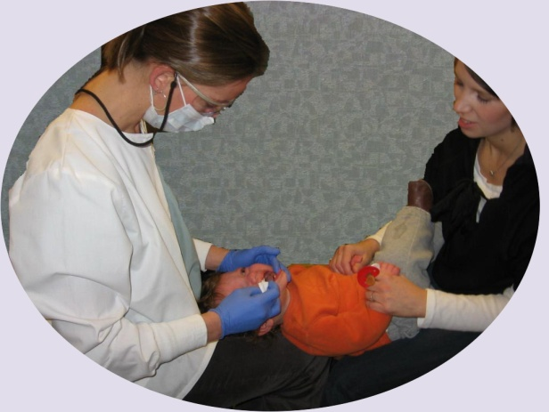


Working Together
CHDP
Medical Providers
Together we can stop the epidemic of dental disease!
Dental Providers
Parents/Caregivers
Individuals
  For local CHDP contact information –
  www.dhcs.ca.gov/services/chdp/Pages/CountyOffices.aspx
Notes:
Talking Points:
This website (link at bottom) has the contact information for the local/county CHDP offices.
Physicians and medical staff are essential partners and your help is needed!
Remember, we can’t have overall health without oral health.

Slide 49

You have successfully completed the CHDP Dental Training!
  Now…
  Answer the review questions on the next slide to test your knowledge.
  Print brochures and guides for your office, which can be accessed on slides #58-59 following review questions.
  Complete a two minute evaluation of this training located at the end of the reference slides.
CHDP Dental Training : http://www.dhcs.ca.gov/services/chdp/Pages/CHDPDentalTraining.aspx
Notes:
Preparation:
Be sure this link is noted on written materials given to providers:
http://www.dhcs.ca.gov/services/chdp/Pages/CHDPDentalTraining.aspx
This link is also located on the training packet label.
Talking Points:
The next section consists of review questions, followed by a slide with useful brochures and guides you can print for your office.
At the very end of this presentation we would appreciate you taking a few minutes to complete a short evaluation of this training.

Slide 50

Training – Review Questions
Click to next slide for answers
Notes:
Preparation:
Review and print Review Questions located at the bottom of the CHDP Dental Training Home Page under Local CHDP Training Documents (Printable).
Have a copy of the test for each participant.
Speaker Tips:
Hand out the Review Questions to each training participant.
Trainer can direct participants to either:
Work individually
Read all the questions and write the answers on the pages as directed.
Then, as a group, go through the slide answers together.
Or
Work together
Read each question one at a time, and participants can write the answer and discuss as a group activity.

Slide 51

Answers for questions #1 - #3 shown in yellow (Explanations under each photo)
Notes:
Speaker Tip:
Read questions and answers aloud.
Talking Points:
(Question #3) Photos represent no visible decay or gum inflammation - Class I. Only the routine dental referral box would be checked.
Class I does not require documentation in the “comments” section.

Slide 52

Click to next slide for answers

Slide 53

Answers for question #4 shown in yellow
(Explanations under each photo)
Notes:
Speaker Tip:
Read the explanation under each photo out loud to the providers.
Talking Points:
As shown in the “comments” box, this is the minimum you should write. The more details you can share, will help CHDP staff provide follow-up care coordination.
These conditions are serious and can progress rapidly to an emergency, be sure to advise parent to make a dental appointment today.

Slide 54

Click to next slide for answers cont.

Slide 55

Answers for question #5
shown in yellow (Explanations under each photo)
Notes:
Speaker Tip:
Read the explanation under each photo out loud to the providers.
Talking Point:
As shown in the “comments” box, this is the minimum you should write. The more details you can share, will help CHDP staff provide follow-up.
Class II conditions can easily be missed and will progress if left untreated. Advise parents to make a dental appointment soon.

Slide 56

Click to next slide for answers cont. 2

Slide 57

Answers for question #6
shown in yellow
(Explanations under each photo)
Notes:
Speaker Tip:
Read the explanation under each photo out loud to the providers.
Talking Points:
Emphasize to parents that this is an emergency condition and needs to be seen by a dentist immediately.
Assist family to make a dental appointment before leaving your office.

Slide 58



















Printable Educational Materials
Growing Up Healthy (14 age-specific brochures)
http://www.dhcs.ca.gov/formsandpubs/publications/Pages/CHDPPubs.aspx#brochures
Every Child Needs a Dental Home
http://www.cdph.ca.gov/programs/MCAHOralHealth/Pages/PublicationsandReports.aspx
Fluoride Varnish
http://www.cdph.ca.gov/programs/MCAHOralHealth/Pages/PublicationsandReports.aspx
CHDP Oral Health Educational Resources
  For babies and young children (Birth-5)
  http://www.sfdph.org/dph/files/dentalSvcsdocs/OralHlthResourceBir5Yrs.pdf
  Children and teens (6-20)
  http://www.sfdph.org/dph/files/dentalSvcsdocs/OralHlthResource6-20.pdf
Medi-Cal Dental Benefits
http://www.denti-cal.ca.gov/WSI/Bene.jsp?fname=BeneSrvcs
Prevent Tooth Decay in Babies and Toddlers
http://www.cdph.ca.gov/programs/MCAHOralHealth/Pages/PublicationsandReports.aspx
Notes:
Preparation:
Print copies of the Dental Training Home Page to give to participants.
www.dhcs.ca.gov/services/chdp/Pages/CHDPDentalTraining.aspx
Speaker Tips:
Use the copy of the Home Page to explain to providers that they can access the CHDP Dental Training and printable materials from that page.
Be sure to make note of the CHDP Dental Training web address at the bottom of the printed Dental Home Page.
Talking Points:
There are many training modules and printable materials available for your use and review. You can access them through the home page.
You can also Google/Bing CHDP Dental Training to access the site.

Slide 59







Provider Guides
Providers can print each guide and use as a quick reference
Oral Health for Infants and Toddlers - A Medical
Providers Guide
http://www.cdph.ca.gov/programs/MCAHOralHealth/Documents/MO-OHP-OralHealthInfantToddler.pdf
Periodicity Table
http://www.dhcs.ca.gov/services/chdp/Documents/Letters/chdppin1110.pdf
PM160 Dental Guide
http://www.dhcs.ca.gov/formsandpubs/publications/Documents/CMS/pm160dentalguide.pdf
Orthodontic/Craniofacial Referral Guide
http://www.cdph.ca.gov/programs/MCAHOralHealth/Documents/MO-OHP-OrthodonticCraniofacialReferralGuide.pdf
Notes:
Talking Points:
The guides on this slide can also be accessed online through this slide in the PPT training, or on the CHDP Dental Home Page: www.dhcs.ca.gov/services/chdp/Pages/CHDPDentalTraining.aspx

Slide 60
Training Modules
Risk Assessment
  American Academy of Pediatrics
  http://www2.aap.org/commpeds/dochs/oralhealth/RiskAssessmentTool.html
Oral Health Oral Assessment
  American Academy of Pediatrics - Video
  http://www.youtube.com/watch?v=vRodm0Zxvfw
  First Five California-Video
  http://www.youtube.com/watch?v=UF4Ra1ZgovI
  Smiles for Life- University of Connecticut - Video
  http://www.youtube.com/user/aaptv#p/search/1/Hw99Aoti7ZE
Fluoride Varnish
  Smiles for Life - Video
  http://www.youtube.com/watch?v=cV5OmL7C8K4&feature=player_embedded
  American Academy of Pediatrics - Video
  http://www.youtube.com/watch?v=zNOlGS1ggSg&feature=player_embedded
  Maryland’s Mouths Matter - Training Modules
  http://www.ohmdkids.org/flvarnish/
Notes:
Talking Points:
The training modules from this presentation are summarized here. You can access them through the CHDP Dental Training PPT online or at the bottom of the Home Page.

Slide 61
REFERENCES
Problem Statement
  http://www.healthysmilesoc.org/Documents%20for%20Site/California%20Smile%20Survey.pdf
  http://cdhp.org/resource/gao_report_dental_disease_chronic_problem_among_low_income_populations
Risk Assessment
  http://www2.aap.org/commpeds/dochs/oralhealth/RiskAssessmentTool.html
  http://www.mchoralhealth.org/pocketguide/tables1.html
  http://www.cda.org/library/cda_member/pubs/journal/jour0303/consensus.htm
Fluoride Assessment and Supplementation
  http://www.cdc.gov/mmwr/preview/mmwrhtml/rr5014a1.htm#tab1
  http://www.cdph.ca.gov/certlic/drinkingwater/Documents/Fluoridation/Fluoridationdatafor2008.pdf
Health Assessment /Health Assessment Guidelines
  http://www.youtube.com/watch?v=vRodm0Zxvfw
  http://www.dhcs.ca.gov/services/chdp/Pages/Pub156.aspx
Anticipatory Guidance
  http://www.mchoralhealth.org/PediatricOH/mod4_2_3.htm
  http://www.cdc.gov/OralHealth/publications/factsheets/sealants_faq.htm
  http://www.cdafoundation.org/library/docs/jour1007/ramos.pdf
  http://www.dhcs.ca.gov/formsandpubs/publications/Pages/CHDPPubs.aspx#brochures
Dental Emergencies
  http://www.ebmedicine.net/topics.php?paction=showTopicSeg&topic_id=32&seg_id=577
    Referrals
    Periodicity Table
    http://www.dhcs.ca.gov/services/chdp/Documents/Letters/chdppin1110.pdf
  Dental Home
    http://pediatrics.aappublications.org/content/111/5/1113.full.pdf
  Provider to Provider Referral Form
    http://sdcounty.ca.gov/hhsa/programs/phs/documents/FINALMedical_Provider_Referral_to_DentistFillANDSave.pdf
Notes:
Talking Point:
The references for this presentation are listed here in the order in which they appeared in the PPT training. You can access them through the CHDP Dental Training PPT online or at the bottom of the Home Page.

Slide 62
REFERENCES cont.
Malocclusion and Craniofacial Referral
  www.dhcs.ca.gov/services/CCS/pages/countyoffices.aspx
  Denti-Cal
  http://www.denti-cal.ca.gov/WSI/Default.jsp?fname=Default
Fluoride Varnish
  Effectiveness
      www.ncbi.nlm.nih.gov/pmc/articles/PMC2257982/?tool=pubmed
    Who Can Apply
      http://www.dhcs.ca.gov/services/chdp/Documents/Letters/chdppin0608.pdf
      http://files.medi-cal.ca.gov/pubsdoco/publications/masters-mtp/part2/dental_m00o03o09.doc
      http://cda.org/popup/cda-sponsored_legislation_clarifies_who_can_place_topical_fluoride_including_fluoride_varnish
  Parent Brochure
      http://www.cdph.ca.gov/programs/MCAHOralHealth/Documents/MO-OHP-FluorideVarnish–English.pdf
    Training Modules
      http://www.youtube.com/watch?v=cV5OmL7C8K4&feature=player_embedded
      http://www.youtube.com/watch?v=zNOlGS1ggSg&feature=player_embedded
      http://www.ohmdkids.org/flvarnish/
  Billing Code
    http://files.medi-cal.ca.gov/pubsdoco/publications/masters-mtp/part2/dental_m00o03o09.doc
************************************************************
  For local CHDP contact information:
  www.dhcs.ca.gov/services/chdp/Pages/CountyOffices.aspx
  Photos and graphics in this training were used by permission or from public domain.
Notes:
Talking Point:
The website located at the bottom of this slide lists the local CHDP offices and their contact information. This information is also found on the State CHDP Website under Individuals, Contact a CHDP Program.
http://www.dhcs.ca.gov/services/chdp/Pages/CountyOffices.aspx

Slide 63

THANK YOU for being a partner in promoting oral health!
  To help us improve this training, please complete an
  anonymous 2 minute online evaluation
To return to the beginning of training click HERE
Notes:
Preparation:
Please note there are two evaluation formats:
Printable version for in-person presentations -
Can be downloaded from the CHDP Dental Training Homepage.
Located under Local CHDP Program Training Documents (Printable).
Print an evaluation for each participant.
“Online” version for self trainings –
Can be accessed by clicking the link on this slide in the online PPT, or on the Homepage (under PPT Training).
Talking Points:
Thank you for participating in our CHDP Dental Training. We appreciate your time and effort in promoting oral health!
Please take a few minutes to fill out the evaluation and return it to me.

