Slide 1
Medi-Cal Managed Care
Advisory Group Meeting
June 3, 2021 – (WebEx Only)
WebEx Meeting Number (access code): 145 594 2590
Meeting Password: MCAG*
Join by video system: Dial 1455942590@dhcs.webex.com
You can also dial 173.243.2.68 and enter your meeting number.
Join by phone: +1-415-655-0001 US Toll
Access Code: 145 594 2590

Slide 2
Agenda
Welcome and Introductions
DHCS COVID-19 Updates
  Encounter Data Trends
  Vaccinations
Chief Quality Officer
Preventative Care Outreach Project
Asian Disparities Focused Study
Updates
  Managed Care Project Updates
  Ombudsman Report
  Blood Lead Screening
  Network Monitoring 2021
  CalAIM
All Plan Letters (APLs) and Dual Plan Letters (DPLs) Update
Open Discussion
Next Meeting – September 2, 2021

Slide 3
Welcome and Introductions

Slide 4
DHCS COVID-19 Updates

Slide 5
Encounter Data and Grievance Trends
Philip Jimenez
Data Analytics Branch, Chief
Managed Care Quality & Monitoring

Slide 6
Outpatient and Prescription Utilization Trends
Data Source: MIS/DSS | Data Represents: January 2020 – December 2020 | Date Downloaded: 05/14/2021

Slide 7
ER, Inpatient, and Mild to Moderate Mental Health Utilization Trends
Data Source: MIS/DSS | Data Represents: January 2020 – December 2020 | Date Downloaded: 05/14/2021

Slide 8
Grievances Trends
Data Source: Enterprise Performance Monitoring | Data Represents: April 2019– September 2020 | Date Downloaded: 05/14/2021

Slide 9
Questions?

Slide 10
Vaccinations
Philip Jimenez
Data Analytics Branch, Chief
Managed Care Quality & Monitoring

Slide 11
Exchange Updates
DHCS provides two COVID-19 vaccine data files to Medi-Cal managed care plans (MCPs):
  Fee-for-service (FFS) claims data file
  The California Immunization Registry (CAIR2) data file
On February 4, DHCS began transferring member specific COVID-19 vaccination FFS claims data to Medi-Cal MCPs, with weekly data transfers occurring every Wednesday thereafter.

Slide 12
Exchange Updates
On March 26, DHCS’ Managed Care Quality & Monitoring Division (MCQMD) began transferring member specific COVID-19 vaccination CAIR2 data as it became available.
Throughout the month of April, DHCS resolved data quality issues with CAIR2, made system and process improvements for more frequent reporting, and provided several updates.
On May 13, DHCS began a weekly refresh of COVID CAIR2 data.

Slide 13
Questions?

Slide 14
Chief Quality Officer
Palav Babaria, MD, MHS
Deputy Director and Chief Quality Officer
Quality and Population Health Management

Slide 15
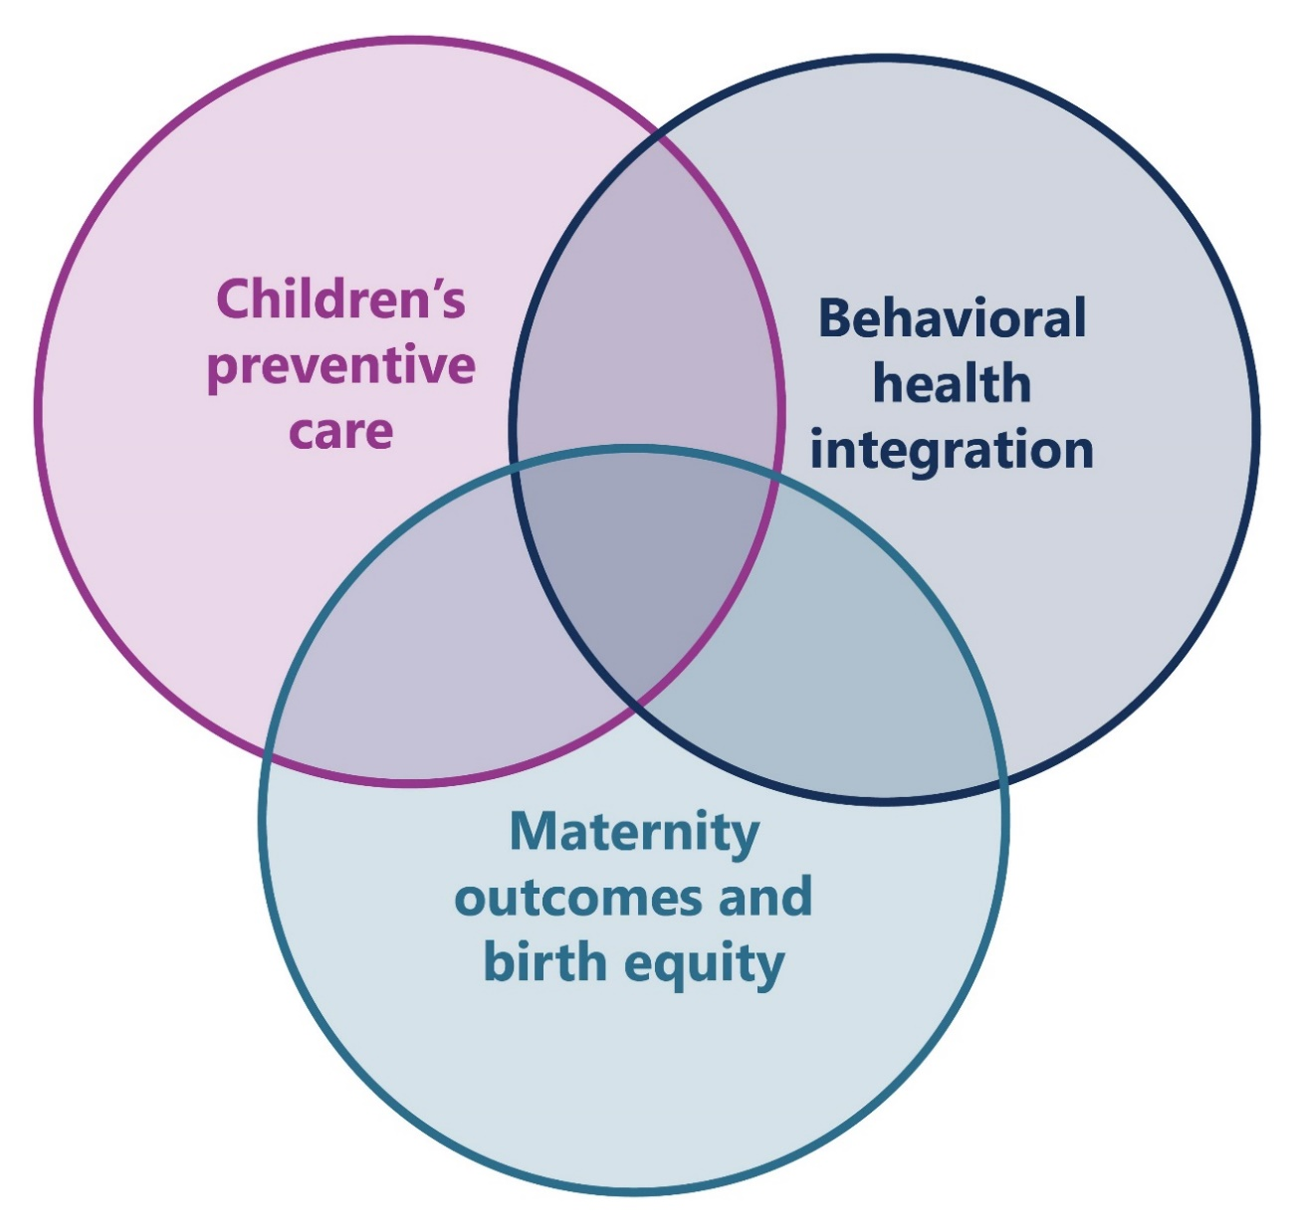
Road to Recovery

Slide 16
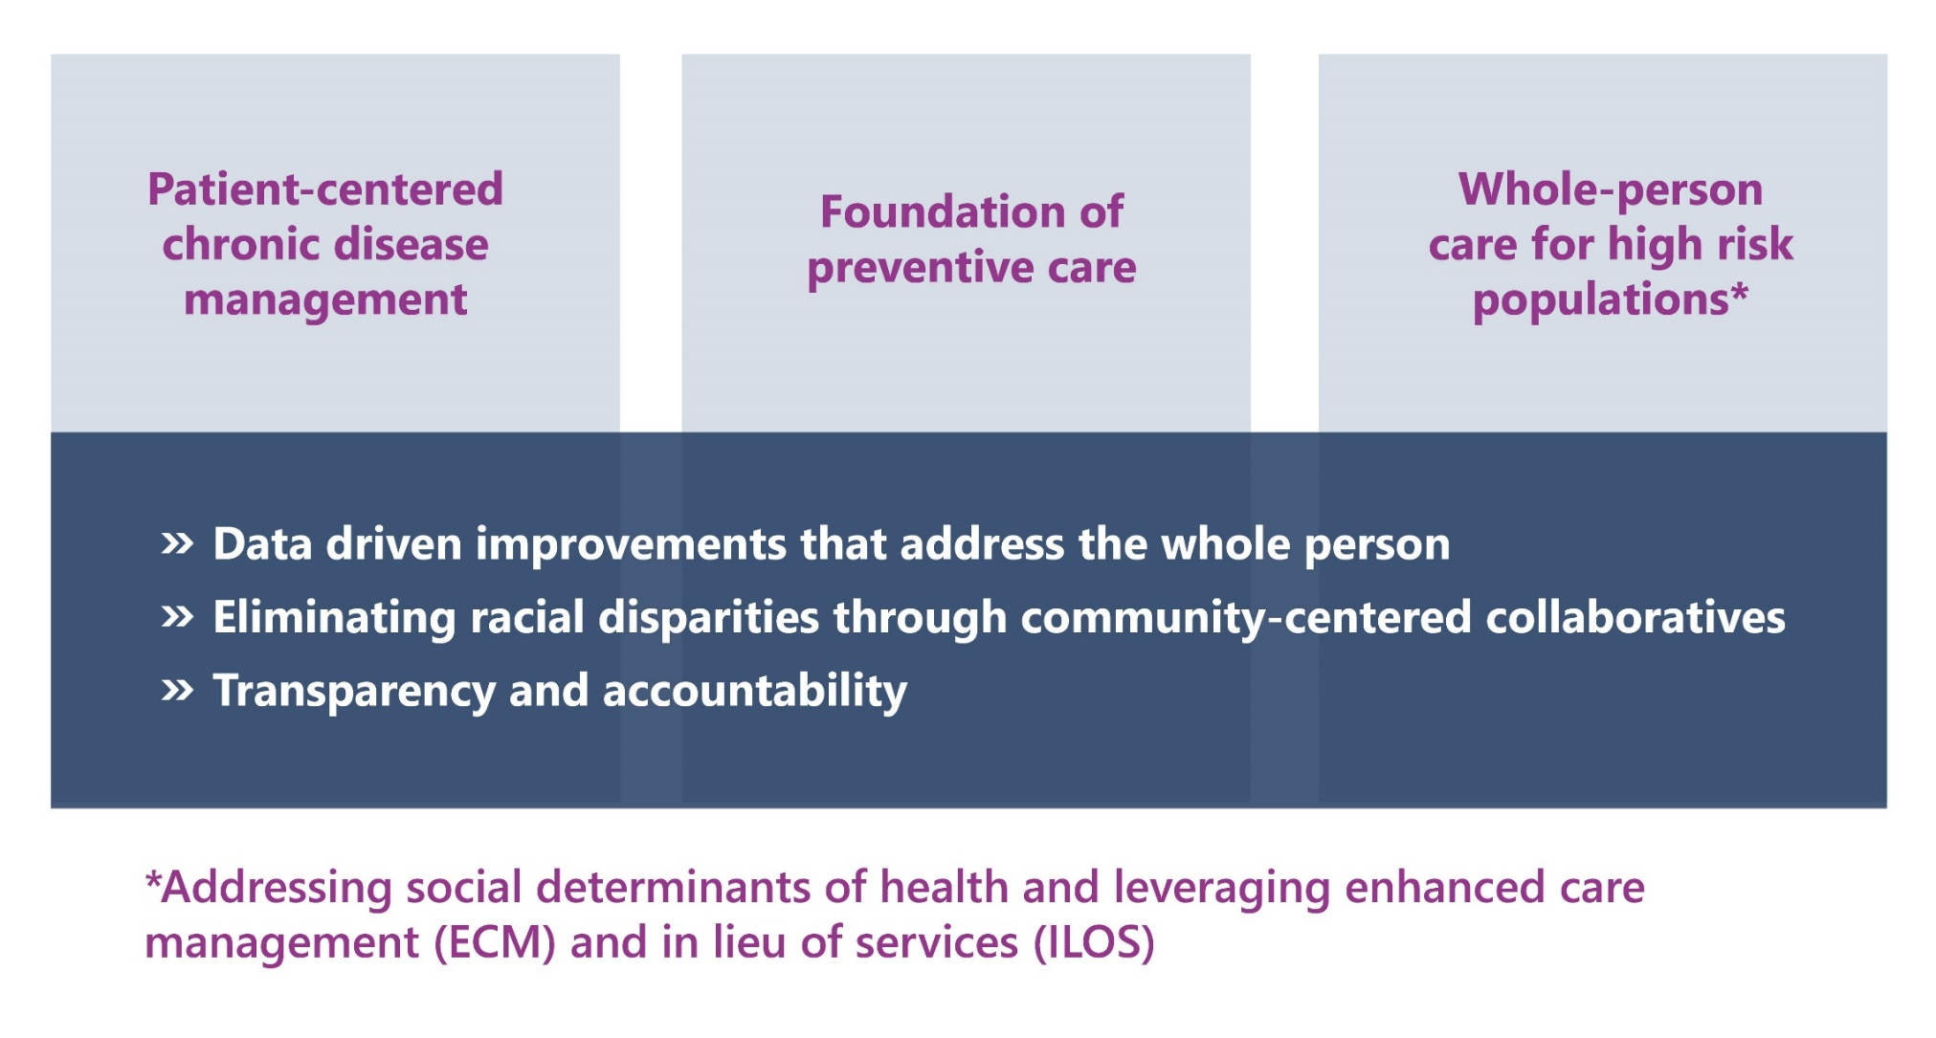
CalAIM and Population Health: The Future of Medi-Cal

Slide 17
Q&A and Feedback

Slide 18
Preventive Care Outreach
Member Testing
Nicole Donnelly
Vice President, Center for Health Literacy
Heather M. Jones
Senior Manager, Center for Health Literacy

Slide 19

Agenda
1 | 2 | 3
Background | Key Findings | Next Steps

Slide 20

Background
Communication assessment
Stakeholder interviews
Sample materials development
Member testing

Slide 21
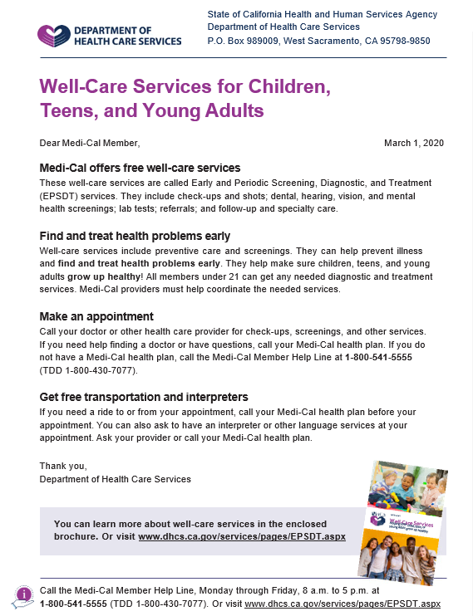
Draft: Print Materials

Slide 22
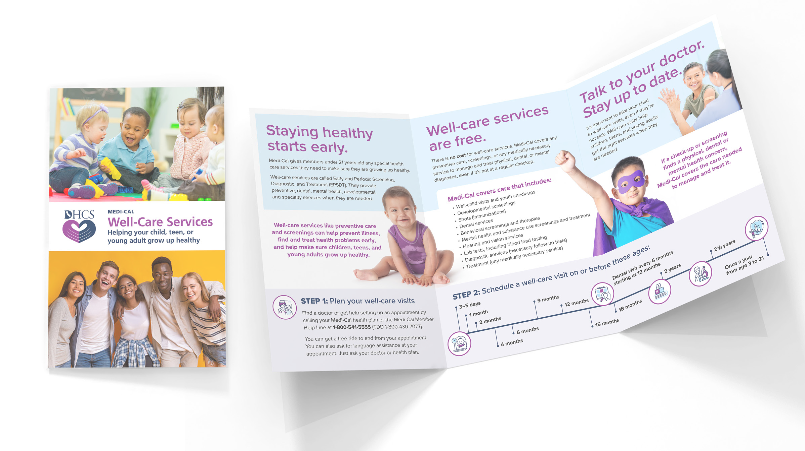
Draft: Print Materials

Slide 23
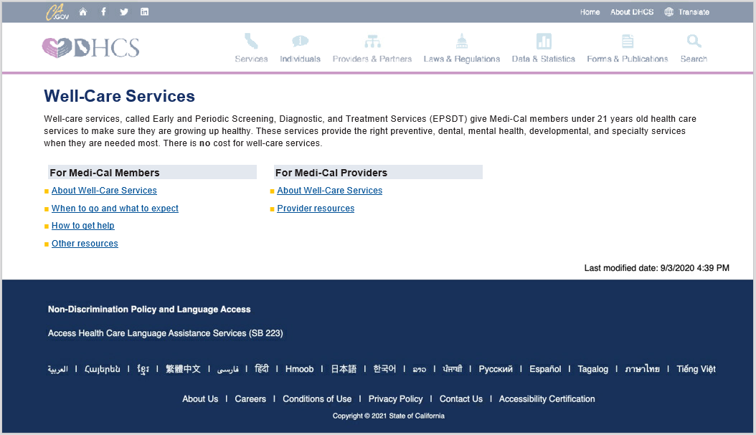
Draft: Website

Slide 24
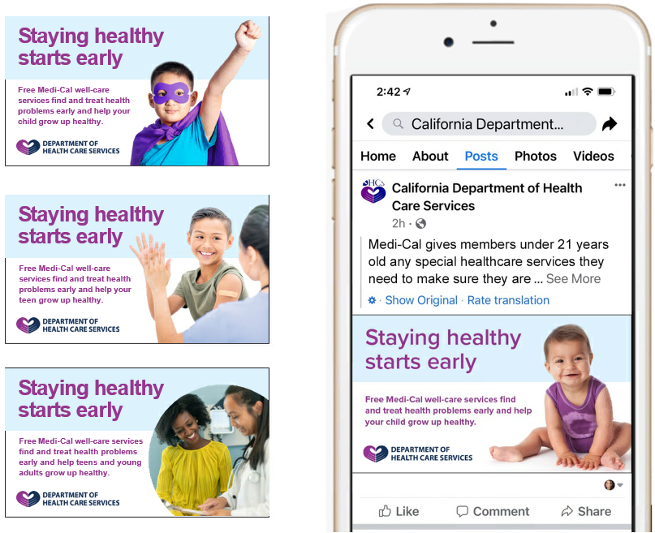
Draft: Social Media

Slide 25
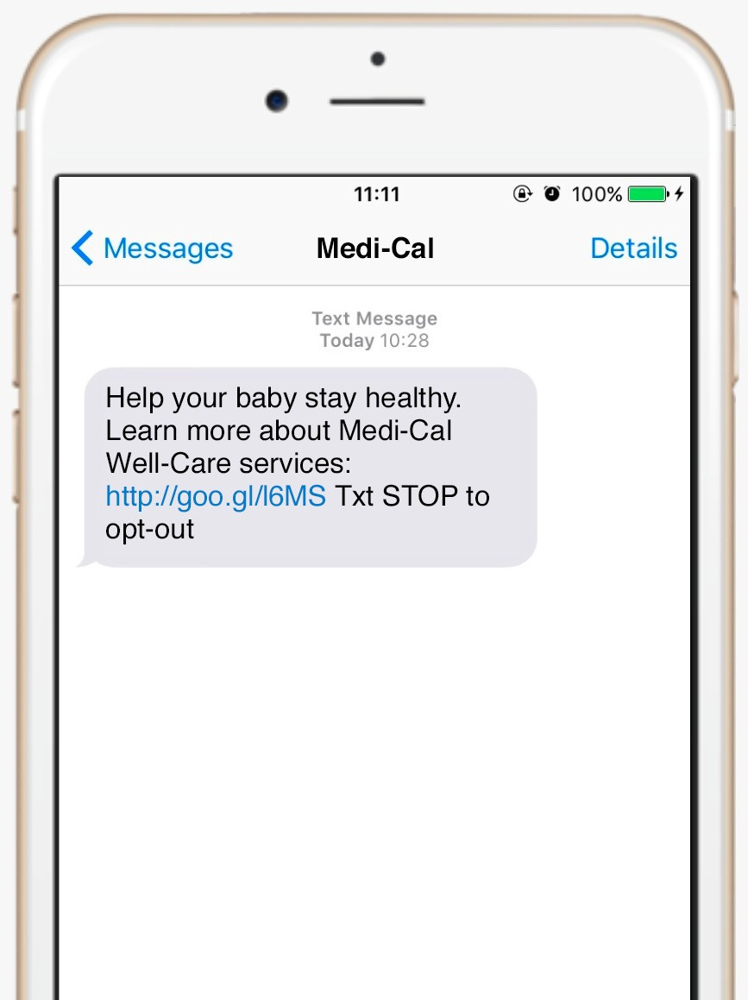
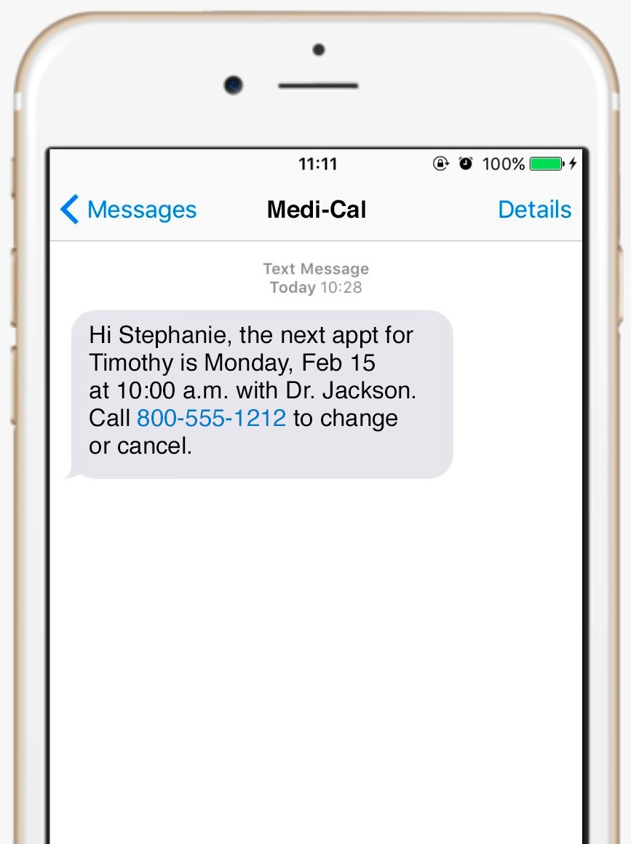
Draft: Text Messages

Slide 26
Method
One-on-one interviews by web or phone
Interview questions tested efficacy
Mix of members, targeting those with lower utilization rates

Slide 27
Sample
65 participants
Equal mix of English, Spanish, Mandarin, Korean, and Russian speakers
Mix of:
  Ethnicities
  Counties and urbanicity
  Parent or caregiver age, age of children, and young adult members
  Education
  Gender

Slide 28
Key Findings: Design
Participants liked the colors, images, and design
  A few mentioned liking the diversity of the photos
Most found the information easy to read and well organized

Slide 29
Key Findings: Content
Readability
  Almost all participants found the materials easy to read
Key messages
  Important information was clear
Translation
  Translated materials tested well. Some participants found a few translated terms (EPSDT, young adults, shots) confusing.

Slide 30
Key Findings: Channels
Information source
  Providers and Medi-Cal (DHCS) were most trusted.
Channels
  Email was most preferred, followed by text and mail.

Slide 31
Next Steps
Update materials based on member testing

Slide 32
Questions?

Slide 33
Asian Subpopulations: Focused Study Report on Health Disparities
Ying Marilyn Kempster, MPH
Health Education Consultant III
Quality & Medical Policy Branch

Slide 34
Background
A health disparity is the difference in health outcomes between groups within a population.
Previous health disparities studies showed that the Asian group had better rates for 65 percent of all indicators compared to the reference group. However, the high performance of the Asian group was primarily driven by the relative high performance of four of the largest Asian subpopulations.
When the indicators were stratified by primary language, the rates for several of the Asian languages were lower than the rates for English speakers for certain indicators.
This focused study breaks out the Asian population into 10 Asian subpopulations to assess health disparities.
The study also assesses health disparities based on language.

Slide 35
Analyses
Compared the indicator rates for the individual Asian racial/ethnic subpopulations to the rates for the White group.
Compared the rates for the primary language subpopulations to the rates for the English group.
Compared the rates within each Asian subpopulation of those whose primary language is not English with those whose primary language is English.
  E.g., the rates for Korean speakers within the Korean racial/ethnic subpopulation compared to the rates for English speakers within the Korean racial/ethnic subpopulation.

Slide 36
Race by Reporting Year
Racial/Ethnic Group | Reporting Year 2017 | Reporting Year 2018 | Reporting Year 2019
White Total | 2,498,757 | 2,392,766 | 2,256,448
Asian Total | 1,447,763 | 1,180,840 | 1,107,031
Amerasian | 0.1% | 0.1% | 0.1%
Asian Indian | 7.5% | 9.6% | 10.1%
Cambodian | 2.6% | 3.3% | 3.5%
Chinese | 18.2% | 21.8% | 22.5%
Filipino | 14.5% | 17.3% | 17.3%
Japanese | 1.1% | 1.2% | 1.3%
Korean | 5.5% | 6.4% | 6.5%
Laotian | 1.8% | 2.2% | 2.2%
Other Asian or Pacific Islander | 30.4% | 15.8% | 13.3%
Vietnamese | 18.4% | 22.3% | 23.3%

Slide 37
Subpopulations by Primary Language
Primary Language Group | Reporting Year 2017 | Reporting Year 2018 | Reporting Year 2019
English Total | 8,031,771 | 7,995,272 | 7,844,687
Asian Primary Language Total | 726,667 | 729,979 | 704,789
Arabic | 6.4% | 6.7% | 6.7%
Armenian | 6.5% | 7.3% | 7.5%
Cambodian | 2.1% | 2.1% | 2.0%
Cantonese | 16.1% | 16.0% | 16.1%
Farsi | 4.2% | 4.5% | 4.5%
Hmong | 3.6% | 3.4% | 3.2%
Ilocano | 0.1% | 0.1% | 0.0%
Japanese | 0.2% | 0.2% | 0.2%
Korean | 5.6% | 5.1% | 4.8%

Slide 38
Subpopulations by Primary Language (continued)
Primary Language Group | Reporting Year 2017 | Reporting Year 2018 | Reporting Year 2019
English Total | 8,031,771 | 7,995,272 | 7,844,687
Asian Primary Language Total | 726,667 | 729,979 | 704,789
Lao | 0.8% | 0.7% | 0.7%
Mandarin | 9.9% | 9.7% | 9.8%
Mien | 0.3% | 0.3% | 0.3%
Other Chinese | 1.3% | 1.0% | 0.9%
Other Non-English** | 8.0% | 8.3% | 8.4%
Russian | 4.7% | 4.8% | 4.9%
Tagalog | 4.7% | 4.5% | 4.2%
Thai | 0.3% | 0.3% | 0.3%
Vietnamese | 25.5% | 25.2% | 25.5%

Slide 39
Subpopulations by Primary Language
Race/Ethnicity | Dominant Non-English Language
Asian Indian | Other Non-English
Cambodian | Cambodian
Chinese | Cantonese, Mandarin
Filipino | Tagalog
Japanese | Japanese
Korean | Korean
Laotian | Lao, Hmong
Other Asian or Pacific Islander | All Other Languages
Vietnamese | Vietnamese

Slide 40
Methodology
Evaluated External Accountability Set (EAS) performance indicators for three reporting years (2017–2019).
Aggregated results from 25 full-scope MCPs and then stratified these statewide rates by the Asian racial/ethnic subpopulations, primary language subpopulations, and the Asian subpopulation’s dominant non-English language.
Only identified health disparities based on statistical analysis for the Asian racial/ethnic subpopulations and the primary language subpopulations for reporting years 2017–2019.

Slide 41
Methodology
Disparities were analyzed for three reporting years. Out of the three reporting years, if a subgroup had indicator rates that were better than the reference group two out of the three years, they are considered as having performed “better”. If a subgroup had indicator rates that were worse than the reference group two out of the three years, they are considered as having performed worse than the reference group. If a subgroup had indicator rates that were similar to the reference group two out of the three years, they are considered as having performed “similarly” to the reference group.

Slide 42
Race/Ethnicity Analysis

Slide 43
Race/Ethnicity Analysis

Slide 44
Primary Asian Language Analysis

Slide 45
Primary Asian Language Analysis

Slide 46
English Speaker X Non-English Primary Language of Same Race

Slide 47
Overall Conclusion
All Asian race subpopulations had a majority of indicators that had rates that were statistically significantly similar or better to the reference group (White).
While the overall Asian population is performing well, smaller subpopulations did not perform equally well relative to the reference group.
All Asian non-English language subgroups had a majority of indicators that had rates that were similar or better to the reference group (English). However, smaller language groups did not perform equally well.

Slide 48
Overall Conclusion (Cont.)
The rates for each individual Asian subpopulation’s dominant non-English primary language was largely similar or better compared to the rates for the English primary language for that Asian subpopulation for the majority of indicators, except for Mien and Lao primary languages.
While it is encouraging that the analysis found there are few indicators where the Asian population overall is experiencing health disparities, certain health disparities were detected in subpopulations.
  It seems that the same groups are impacted whether it is tied to race or language.

Slide 49
Recommendations
Continue to monitor health disparities based on race/ethnicity and language, especially those experienced by small subgroups.
Consider investigating health disparities related to the threshold primary languages in future health disparities reports.
Consider working with MCPs to identify factors that may be associated with lower indicator rates in the smaller subgroups. (e.g., lack of access to providers, provider behavior, cultural barriers, and possible incomplete data sources)
Consider using a different reference group for future health disparity studies.

Slide 50
Questions?

Slide 51
Updates

Slide 52
Managed Care Project Updates
Michelle Retke
Division Chief
Managed Care Operations

Slide 53
Ombudsman Report
Michelle Retke
Division Chief
Managed Care Operations

Slide 54
Network Monitoring 2021
Cortney Maslyn
Branch Chief
Program Monitoring and Compliance

Slide 55
Blood Lead Screening
Leslie Stribling
Health Program Specialist II
Policy, Utilization and External Relations Branch

Slide 56
CalAIM
Nathan Nau
Division Chief
Managed Care Quality & Monitoring

Slide 57
APLs and DPLs Update

Slide 58
Emergency Guidance for Medi-Cal MCPs in Response to COVID-19
Date Issued: 03/30/2020
Revised: 03/09/2021
APL 20-004 (Revised)
This revised APL provides information to MCPs on temporary changes to federal requirements as a result of the COVID-19 public health emergency (PHE). This APL also expands on the flexibilities granted by the Centers for Medicare & Medicaid Services (CMS) through Section 1135 waiver approvals, as they apply to the managed care delivery system.

Slide 59
Emergency Guidance for Medi-Cal MCPs in Response to COVID-19
Date Issued: 03/30/2020
Revised: 03/09/2021
APL 20-004 (Revised)
Topics covered include State Fair Hearings, Provider Enrollment/Screening, Prior Authorization, Reimbursement for COVID-19 Testing, Blanket Section Waiver Flexibilities for Providers, Pharmacy Services, Telehealth, Transportation, Eligibility, Encounter Data, Health Homes, Initial Health Assessments, and Quality Monitoring Programs & Initiatives. Some of this guidance was previously released in memos to MCPs.

Slide 60
Emergency Guidance for Medi-Cal MCPs in Response to COVID-19
Date Issued: 03/30/2020
Revised: 03/09/2021
APL 20-004 (Revised)
This revised APL addresses CMS approval to modify the timeframes related to the continuation of benefits (i.e., Aid Paid Pending), thereby modifying the guidance in APL 17-006 for the duration of the PHE. Additionally, this revision informed MCPs that DHCS would be temporarily suspending Encounter Data Validation (EDV) activities for the 2019-2020 state Fiscal Year EDV study.

Slide 61
Emergency Guidance for Medi-Cal MCPs in Response to COVID-19
Date Issued: 03/30/2020
Revised: 03/09/2021
APL 20-004 (Revised)
This revision also provided information on CMS approval of State Plan Amendment 20-0025 to allow coverage of laboratory tests and x-ray services during the COVID-19 PHE and any future PHE, if the service is to diagnose or detect COVID-19 or the communicable disease named in a future PHE.

Slide 62
COVID-19 Vaccine Administration
Date Issued: 12/28/2020
Revised: 03/11/2021, 04/30/21, and 05/05/21
APL 20-022 (Revised)
This revised APL provides MCPs with information and guidance regarding COVID-19 vaccine coverage and administration in the Medi-Cal program. This APL reminds MCPs that although both the COVID-19 vaccines and associated administration fees are carved out of the managed care delivery system to Medi-Cal FFS, MCPs remain contractually responsible for providing case management and care coordination for their members, regardless of whether or not they are financially responsible for the payment of services.

Slide 63
COVID-19 Vaccine Administration (Cont.)
Date Issued: 12/28/2020
Revised: 03/11/2021, 04/30/21, and 05/05/21
APL 20-022 (Revised)
The APL has been revised three times since December 2020. The first revision included information related to an update in vaccine allocation, with providers and MCPs identifying and prioritizing high-risk populations, and reiterated MCP responsibility for providing needed transportation.

Slide 64
COVID-19 Vaccine Administration (Cont.)
Date Issued: 12/28/2020
Revised: 03/11/2021, 04/30/21, and 05/05/21
APL 20-022 (Revised)
The second revision included information related to an update for provider enrollment in the vaccine program; vaccine allocation for all Californians age 16 and older, with continued prioritization for high-risk populations; the MyTurn appointment system and transportation request procedures; guidance on vaccinating homebound members; encouragement for vaccine providers that are also a member’s medical care provider to address care issues; and reporting of vaccine-related transportation grievances.

Slide 65
COVID-19 Vaccine Administration (Cont.)
Date Issued: 12/28/2020
Revised: 03/11/2021, 04/30/21, and 05/05/21
APL 20-022 (Revised)
The third revision included information to clarify that MCPs are not required to utilize MyTurn to arrange vaccine appointments for homebound members, and may continue to coordinate vaccines for homebound members in a way that best meets the population’s needs and based on existing local partnerships; and in-home vaccinations are carved out of the Medi-Cal managed care delivery system.

Slide 66
Medi-Cal Network Provider and Subcontractor Terminations
Date Issued: 03/03/2021
APL 21-003
Supersedes: APL 16-001
This APL clarifies the obligations of MCPs when terminating or initiating terminations of contractual relationships between MCPs, network providers, and subcontractors. This APL also provides exclusionary databases and lists, as well as guidance on the member notification and reporting requirements for contract terminations; ensures network adequacy compliance; authorizes continuity of care and out-of-network access; and includes payment requirements.

Slide 67
Standards for Determining Threshold Languages, Nondiscrimination Requirements, and Language Assistance Services
Date Issued: 04/08/2021
APL 21-004
Supersedes: APL 17-011 and Policy Letters 99-003, 99-004
This APL informs MCPs of the dataset for threshold and concentration languages, as determined by DHCS, and clarifies the threshold and concentration standards specified in state and federal law and MCP contracts. This APL also provides guidance on federal and state requirements regarding nondiscrimination, discrimination grievance procedures, language assistance, and communications with individuals with disabilities.

Slide 68
California Children’s Services (CCS) Whole Child Model Program (WCM)
Date Issued: 04/15/2021
APL 21-005
Supersedes: APL 18-023
This APL provides direction and guidance to MCPs participating in the CCSWCM program. This APL also conforms with CCS Numbered Letter (N.L.) 03-0421, which provides direction and guidance to county CCS programs on requirements pertaining to the WCM program.

Slide 69
Network Certification Requirements
Date Issued: 04/27/2021
APL 21-006
Supersedes: APL 20-003
This APL provides updated guidance to Medi-Cal MCPs concerning annual network certification requirements and new requirements pursuant to changes in state and federal law. Additionally, this APL provides expanded procedural guidance and clarifications in an Annual Network Certification Instruction Manual (Attachment B).

Slide 70
Third Party Tort Liability Reporting Requirements
Date Issued: 05/10/2021
APL 21-007
Supersedes: APLs 01-002, 11-012, and 17-021
This APL provides guidance to MCPs on the updated process for submitting service and utilization information and copies of paid invoices/claims for covered services related to third party liability torts to DHCS.

Slide 71
Open Discussion
Next Meeting: September 2, 2021
For questions, comments, or to request future agenda items, please email:
advisorygroup@dhcs.ca.gov

