Slide 1

Health Care Workforce Considerations for California’s 1115 Waiver Renewal
Sunita Mutha, MD, Joanne Spetz, PhD,
Janet Coffman, PhD, and Margaret Fix, MPH
Center for the Health Professions at UCSF
November 20, 2014

Slide 2
Center for the Health Professions
We are the leading source for research insights into the evolving health care workforce and for pioneering training programs that empower leaders to navigate change
Expertise across all health professions
  Workforce policy is a tool to drive delivery system change

Slide 3
Overview of Workforce Issues
  Many Medi-Cal beneficiaries have complex conditions and provider needs
  Many ways to measure provider participation and availability
  Provider distribution varies by geography and by provider type
  Diversity does not mirror population
  High debt burden
  Long pipeline for some professions
  Educational programs may not yield needed competencies
  Need new workforce roles to match needs
  Medi-Cal beneficiaries may have difficulty accessing some types of professionals

Slide 4
Selected Data

Slide 5
Regional Variation in MDs Providing Care per 100,000 in 2013
Source: Medical Board of California Mandatory Survey and California Department of Finance Demographic Unit. Includes only MDs who have completed training and provide at least 20 hours of patient care per week.
Notes:
Not sure this is essential

Slide 6
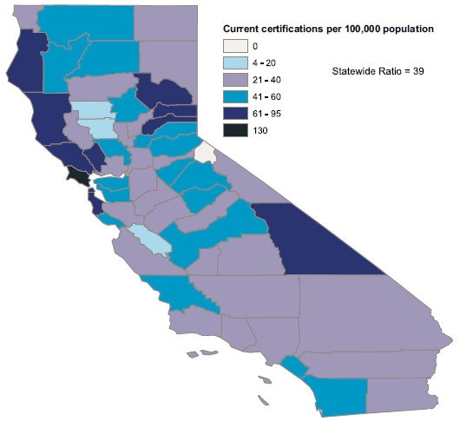
Nurse Practitioners per 100,000 in 2008
Source: Bates, Blash, Chapman, & Dower, 2011

Slide 7
California Physicians Accepting
New Patients By Payer, 2013
Source: Coffman, et al. Physician Participation in Medi-Cal. 2014.

Slide 8
California NPs Accepting New Patients By Payer, 2010
Source: Spetz, et al. 2010 Survey of Nurse Practitioners and Certified Nurse Midwives, 2011.

Slide 9
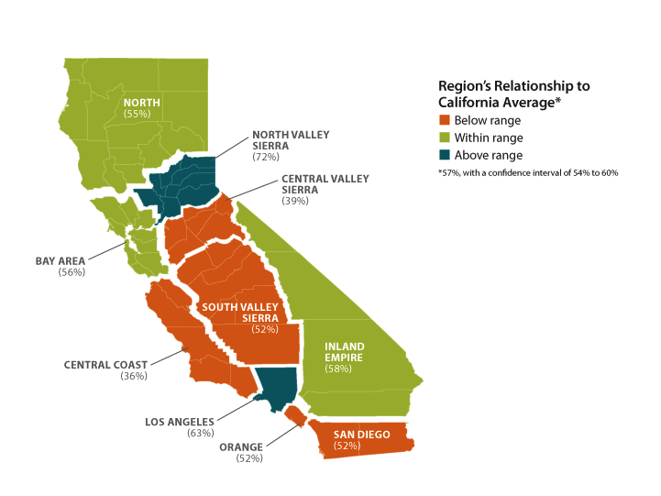
Primary Care Physicians Accepting New Medi-Cal Patients by Region
Source: Coffman, et al. Physician Participation in Medi-Cal. 2014.

Slide 10
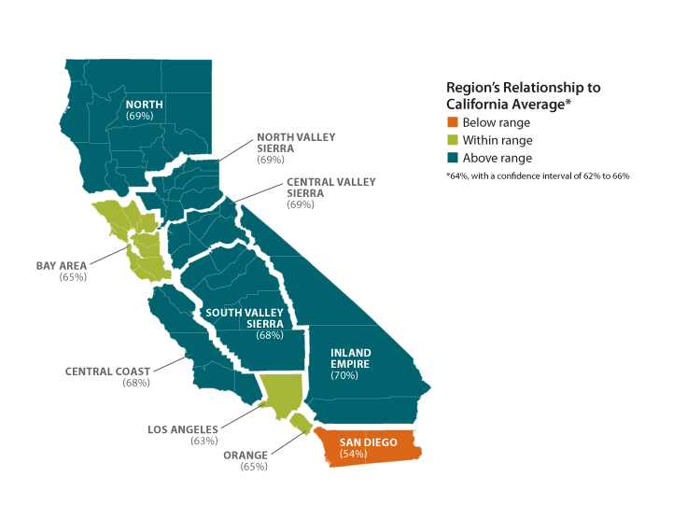
Non-Primary Care Physicians Accepting New Medi-Cal Patients by Region
Source: Coffman, et al. Physician Participation in Medi-Cal. 2014.

Slide 11
Psychologists per 100,000 in 2008
Source: Bates, Blash, Chapman, & Dower, 2011

Slide 12
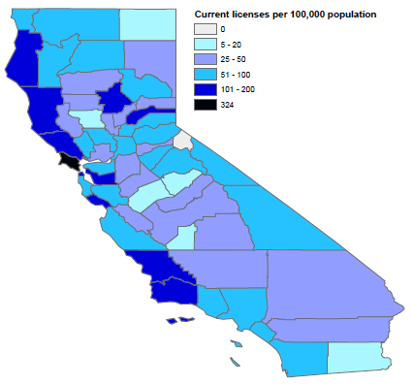
Marriage and Family Therapists per 100,000 in 2008
Source: Bates, Blash, Chapman, & Dower, 2011

Slide 13
3 Proposed Workforce Goals
Increase # in medically underserved areas or who serve a high number of Medicaid beneficiaries
    Train new health professionals
    Increase retention
    Explore practice limitations
    Work with greater efficiency
Develop innovative ways to address whole person care to meet physical and mental health needs
Create incentives to encourage greater commitment to serve Medicaid beneficiaries and practice in underserved areas

Slide 14
Goal 1a: Train New Professionals
Strategy | Example
Train and attract more new health professionals (HP), emphasis on: Train in professions and specialties of greatest need Train in settings with high % of Medicaid beneficiaries Train those most likely to serve Medicaid beneficiaries after completing training | Song-Brown grants State-based Medicaid graduate medical education (GME) for primary care in FQHCs Scholarships (e.g., Health Professions Education Foundation programs) CalSEARCH grants Mental Health Services Act (MHSA) Workforce Education and Training (WET) Program

Slide 15
Goal 1b: Increase Retention
Strategy | Example
Eliminate or reduce barriers for health professionals to continue to serve Medicaid beneficiaries | Loan repayment for HP who care for underserved populations or practice in underserved areas Facilitate physician volunteers who offer free or reduced-rate services

Slide 16
Goal 1c: Explore Practice Limitations
Strategy | Example
Assess the need to change licensure/certification, including expansion of scope Explore options for employers to permit health professionals to practice at the top of their licenses | Expand scope of practice of existing professionals (i.e., SB 493) Community Paramedicine Health Workforce Pilot Project Establish certification protocol for expanded use of MFTs, PAs, and others Advanced practice nurses practice as independently as permitted under law

Slide 17
Goal 1d: Add Greater Efficiency
Strategy | Example
Use technology to expand access to preventive, primary, and specialty care Use new models of care to enable existing health professionals to provide care more efficiently | Team-based care Cross train incumbent workers (e.g., physical plus behavioral health) Group visits Email & other Internet-based care Telehealth Training for IHSS workers to more effectively communicate with other care providers

Slide 18
Goal 2: Innovative Ways to Address Whole Person Care
Strategy | Example
Pilot new categories of service providers such as community health workers, interns, peer support counselors (MH/SUD) Create new categories of health workers and care givers Expand access to desired treatment modalities Coordinate with social, housing, vocational training and other services | MHSA Workforce Education and Training grants Community health workers Peer support and family caregivers IHSS worker training to work with care teams Train physicians in medication assisted therapy to increase access to needed SUD treatment Training & coordination with non-health community services

Slide 19
Goal 3:Create Incentives
Strategy | Example
Reduce barriers to participation in Medicaid Provide financial incentives for participation in exchange for a commitment to serve Medicaid beneficiaries | Subsidize malpractice insurance Malpractice relief for physicians who volunteer Higher payment rates Reduce administrative burden Differential payment for IHSS and other workers who complete additional training Bonus payment pool to Critical Access Hospitals for loan repayment programs

