Slide 1
National Delivery System Reform Incentive Payment Program (DSRIP) Trends & Implications for California
September 2014

Slide 2

What is DSRIP?
A new-ish Medicaid effort operated under a Section 1115 Medicaid waiver program that provides provider financial incentives to:
Support delivery systems changes to meet the triple aim;
Address gaps in care delivery;
Improve hospital operations; and,
Increase care capacity.
States use federal dollars with a match.
Budget Neutrality rules apply.

Slide 3
There is no definition, but DSRIPs seem to share certain traits.
Patient Centered
Better patient care & experience through a more efficient, patient-centered and coordinated system.
Transparent
Decision-making process takes place in the public eye, ensuring processes are clear and aligned across providers.
Collaborative
Collaborative process reflects the needs of the communities and inputs of stakeholders.
Value Driven
Accountable
Providers are held to common performance standards, deliverables and timelines.
Focus on increasing value to patients, community, payers and other stakeholders.
Better Health. Better Outcomes. Reduced Costs.

Slide 4
DSRIP Means New Effort
DSRIP is new work for better outcomes.
Medicaid has a long history of providing supplemental payments for volume of care.
The entire point of DSRIP is to move past notions of a federal subsidy (like DSH).

Slide 5

Progressive Milestones
DSRIP is fundamentally an incentive payment model. FFS and managed care payments still happen. DSRIP plans have:
Incentive payments for meeting relative progress measurements, growing more difficult overtime.
Some states allow partial recognition for partial achievement; others do not.
Payments in early years are generally for process measures; outcome measures in later years.
Beyond improved health outcomes, goals include:
  Better IT integration
  Provider integration
  State Department integration

Slide 6
DSRIP Finance Framework (NY)
Process Metrics
Outcome Metrics & Avoidable Hospitalization
$
Population Health Measures
Time
Notes:
You guys didn’t technically ask for this, but I thought it would be helpful for providers to understand how the financing works to understand the flow of funds. It’s tangentially related to project lifecycle and critical to planning so I put this here thinking you could use it at some point.

Slide 7
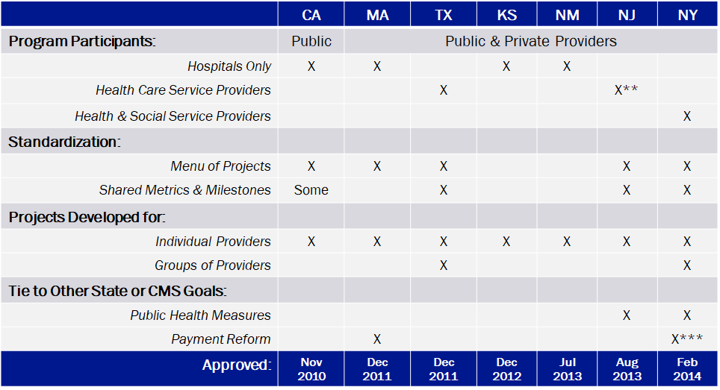
DSRIP States (Implemented)*
* Arizona’s program was never implemented. Florida and Oregon operate DSRIP-like programs, but don’t seem to be considered full DSRIP by CMS.
** New Jersey hospitals encouraged (not required) to work with downstream providers and share payments.
*** New York has a linked statewide 25% reduction in avoidable hospitalization goal that reduces all provider payments if the entire state does not reach that goal.

Slide 8
DSRIP: Smaller Programs
Smaller programs include:
Kansas – limited program involving 2 safety net hospitals, limited standardization of metrics and milestones
Massachusetts – limited program involving 7 public and private safety net hospitals; limited standardization of metrics or projects; a significant focus on payment reform or alternative payment strategies
New Mexico – limited to sole community providers and state teaching hospitals; protocols still in development but each provider has own set of projects

Slide 9
DSRIP: Larger Programs
There are currently seven states total implementing a DSRIP program:
California – 21 public hospitals generally in large, urban counties; limited standardization of metrics or projects
New Jersey – 63 hospitals, however hospitals “strongly” encouraged to work in partnership with other providers; highly tailored menu set of projects & metrics; providers asked to choose a public health goal that all projects had to be linked to
New York – broad program involving a large number of collaborations (40+) including social service providers, very tailored menu set, statewide goal of reducing avoidable hospitalization by 25%
Texas – broad program involving 20+ regional groups, menu of projects still broad but attempt to standardize metrics and milestones

Slide 10
Comparison of DSRIP CA, TX & NY
 | California | Texas | New York
Program Title | Delivery System Reform Incentive Program (DSRIP) | Delivery System Reform Incentive Pool (DSRIP) | Delivery System Reform Incentive Payment (DSRIP) Program
Waiver Approved | November 2010 | December 2011 | February 2014
CMS Approval of DSRIP Framework | March 2011 | Sept 2012 | Protocols still in development
CMS Approval of Individual Plans | March 2011 | June 2013 | Jan-Mar 2014
Duration | 5 Years | 5 Years | 5.5 Years
Federal Funding Available | $3.3B | $5.7B | $6.9B
Participating Entities | 21 Public Hospitals | 20 Regional Healthcare Partnerships (330 public & private providers) | 20-40 Performing Provider Systems (thousands of public & private providers)
DSRIP Category Title | Infrastructure Development Innovation and Redesign Population-Focused Improvement Urgent Improvement in Care LIHP HIV Transition | Infrastructure Development Program Innovation and Redesign Population-Focused Improvement Urgent Improvement in Care | Overall Project Progress System Transformation Clinical Improvements Population-Wide Strategy Implementation
Project Menu Size | 298 Milestones | 1,322 Projects, varying milestones | 44 Projects with specific milestones

Slide 11
DSRIP: Changing Role?
“Originally, DSRIP initiatives were more narrowly focused on funding for safety net hospitals and often grew out of negotiations between states and HHS over the appropriate way to finance hospital care.
Now, however, they increasingly are being used to promote a far more sweeping set of payment and delivery system reforms.”
Kaiser Family Foundation, October 2014

Slide 12
How Does NY DSRIP Work?
“Performing Provider Systems” go through a number of steps to implement DSRIP:
NYS established targeted programs with a menu of projects.
One provider in each region (PPS) is designated as the lead; regions can overlap.
Participating providers select projects off the menu.
DSRIP plans have progressively difficult milestones.
Providers work to achieve the milestones, taking on the risk of missing the milestone.
There must be a source of permissible funds to match federal dollars.

Slide 13
Broad Trends in DSRIP Programs
CMS generally has moved towards:
Narrower menu of projects with pre-approved metrics and milestones.
Collaboration with, and inclusion of, a broad range of providers, including social service providers.
Stretch goals.
  DSRIP accountability bar is being set higher in each state.
  DSRIP goal is statewide payment reform.
More upfront planning—with CMS planning funds.
Standardized and streamlined data reporting.
Notes:
Goal of call to talk about these issues and talk about what are the P&P issues
Learning collaboratives
Waiver protocols
Funding mechanisms
Provider tools & timelines
Best practices from other states – address in CMS/framework for how NY will improve upon what other states have done
Is there a CMS doc that outlines what they are looking for?
Drafting of Terms & Conditions? (no template for that) – SPA amendments, less familiar with
Send CA & TX DSRIP STCs/Waiver + TX learning collaborative docs
Should there be sections we start on early? When momentum begins, state staff pressure to keep ball in CMS court
Learning Collaboratives – little more in concept doc, waiver will say need learning collaboratives, additional attachment defining how they will work
New jersey? DSRIP? Greg/Jason reach out to NJ Commissioner to get a copy

Slide 14

For more information, visit: www.harbageconsulting.com or contact us at: peter@harbageconsulting.com lisa@harbageconsulting.com

