Slide 1
Ground Emergency Medical Transportation (GEMT)
Program Training
Brought to you by:
The Department of Health Care Services (DHCS)
May 2022

Slide 2
House keeping notes
There will not be a Q & A session after this webinar.
These slides will be made available on our website after today’s training.
Please email all questions to the GEMT team at the email address listed below.
GEMT@dhcs.ca.gov

Slide 3
acronyms
  ACA – Affordable Care Act
  CA-MMIS – California Medicaid Management Information Systems
  CMS – Centers for Medicare & Medicaid Services
  CPE – Certified Public Expenditures
  FFCRA – Families First Coronavirus Response Act
  FFP – Federal Financial Participation
  FMAP – Federal Medical Assistance Percentage
  GEMT – Ground Emergency Medical Transportation
  MTS – Medical Transportation Services
  POC – Point of Contact
  SPA – State Plan Amendment

Slide 4
Overview
What is GEMT
Process for new and existing GEMT providers
Who’s who at DHCS
GEMT cost report flow and timeline
Adjusted Schedule 9 and Transport Adjustments
Interim Payment Process
Interim Settlement Process
Final Reconciliation Process
Affordable Care Act Federal Medical Assistance Percentage
Families First Coronavirus Response Act
Upcoming cost report due dates
Metro Fire to discuss DHCS’ Administrative Cost Process (Separate Slide Show)

Slide 5
What is gemt?
GEMT is a supplemental reimbursement program.
  Supplemental reimbursements are available only for the uncompensated care costs incurred by eligible GEMT providers in excess of the already received base payments
GEMT is a Certified Public Expenditure (CPE) based program.
  A certified public expenditure is when a governmental entity (GEMT providers) certifies that the funds expended were public funds and qualify for federal reimbursement. SPA 09-024 gives the GEMT program federal authority to match the non-federal funds with federal funds on eligible expenditures that have been incurred by the public provider. The supplemental reimbursement amount is determined by the methodology outlined in SPA 09-024 and in the GEMT cost report which has been approved by the Centers for Medicare & Medicaid Services (CMS).
The GEMT program is a voluntary program.
  You can choose not to participate in one year and then choose to participate in the next.
GEMT Cost Report submissions and reimbursements must comply with SPA 09-024.

Slide 6
gemt program Eligibility
In order to be eligible for the GEMT program a provider must meet the following:
  Provide GEMT services to Medi-Cal beneficiaries (further defined in SPA 09-024).
  Be enrolled as a Medi-Cal provider for the period being claimed.
  Be owned or operated by an eligible governmental entity, to include the state, a city, county, city and county, fire protection district, special district, community services district, health care district, or a federally recognized tribe.

Slide 7
GEMT Program Enrollment
To enroll into the GEMT Program, providers must:
  Enter into a Provider Participation Agreement (PPA) with DHCS
    SUPPLEMENTAL REIMBURSEMENT PROGRAM PROVIDER PARTICIPATION AGREEMENT
  Submit a GovtTIN Form
    Email GEMT@dhcs.ca.gov to receive a GovtTIN Form.
  Complete the GEMT Point of Contact (POC) Form (You’re welcome to submit multiple POC forms)
    GROUND EMERGENCY MEDICAL TRANSPORTATION POINT OF CONTACT INFORMATION
    Send form to GEMT@dhcs.ca.gov and cc Metro Fire at GEMT@metrofire.ca.gov
  Agree to reimburse DHCS’ administrative costs associated with overseeing the program (the provider’s allocated costs will be collected by Sacramento Metropolitan Fire District on behalf of DHCS).
    Email Metro Fire at GEMT@metrofire.ca.gov for more information and to receive a copy of their agreement form.
  Complete annually, a GEMT cost report certifying public expenditures for this program.

Slide 8
Annual requirements for Enrolled providers
PPAs are evergreen, they do not need to be submitted annually. Once executed, the agreement stands until one or both parties wishes to terminate or edit.
Billing service agreements must be current for the applicable state fiscal year (SFY).
Submit cost reports by November 30th.
  Please note, the cost report submission deadline will be different for retroactive SFYs 2018-19, 2019-20, and 2020-21 (to be addressed in a later slide).

Slide 9
Who’s Who at dhcs
Audits and Investigations Division
  Cost Reporting and Tracking Section (CRTS)
    Monitors the GEMTSubmissions@dhcs.ca.gov mailbox
    Completes initial review of submitted cost reports
    Sends cost report acceptance emails to providers
    Sends requests additional information
    Sends cost report rejection emails

Slide 10
Who’s Who at dhcs
Safety net financing division
Safety Net Financing Division (SNFD)
  Monitors the GEMT@dhcs.ca.gov mailbox
  Provides oversight and guidance on GEMT program
  Enrolls new GEMT providers into the GEMT program
  Monitors and executes the PPAs
  Processes GEMT Interim Payments, Interim Settlements, and Final Reconciliations
  Report and track expenditures to federal government

Slide 11
Who’s Who at dhcs
Audits and Investigation Division
Audits and Investigations Division
  Financial Audits Branch (FAB)
    Conducts final audits of GEMT cost reports
    Issues audit findings to GEMT providers and SNFD
* FAB does not process payments or recoupments as a result of audit findings. SNFD processes final reconciliation payments and recoupments.

Slide 12
GEMT Cost Report Flow and timeline
Step 1
  The GEMT Cost Report and Instructions were emailed to providers on May 18, 2022.
  The GEMT Cost Report and Instructions can also be found on the GEMT website (GENERAL INSTRUCTIONS FOR COMPLETING COST REPORT FORMS).
Step 2
  GEMT provider fills out cost report, signs, and dates certification page.
  GEMT provider submits signed PDF and Excel versions of cost report to GEMTSubmissions@dhcs.ca.gov with a cc to GEMT@dhcs.ca.gov by the designated due date.
    Please submit one cost report per SFY per email.

Slide 13
GEMT Cost Report Flow and timeline Continue 1
Step 3
  CRTS reviews cost report.
  CRTS sends acceptance email to provider, requests additional information, or rejects cost report within 90 days of receipt.
  If cost report is rejected provider must make edits and resubmit signed PDF and Excel version as soon as possible.
Step 4
  Upon receipt of the accepted cost report, SNFD will begin the invoice process. Invoice goes through 3 levels of review/signature.
  Invoice is sent to DHCS Accounting Section for processing. Accounting Section has 10 business days to process and send payment information to the State Controllers Office (SCO).

Slide 14
GEMT Cost Report Flow and timeline Continue 2
Step 5
  SCO processes invoice and issues Warrant/Check. SCO has 15 business days to issue warrant.
  Warrant is mailed to GEMT provider. Allow 3-5 business days for delivery.
Step 6*
  2 years after the close of each SFY, SNFD will conduct interim settlement.
  SNFD will process invoice for providers who were underpaid. Invoice will go through steps 4 and 5.
  SNFD will send demand letter to providers who were overpaid. Providers have 60 days to remit payment to SNFD.
*Due to timing, SFY 18/19, SFY 19/20, & SFY 20/21 will not have a interim settlement. DHCS will only conduct final reconciliations for these SFYs based on final audits.

Slide 15
GEMT Cost Report Flow and timeline Continue 3
Step 7
  FAB conducts final audit within 3 years of accepted cost report.
Step 8
  SNFD will conduct final reconciliations based on final audit.
    SNFD will process invoice for providers who were underpaid. Invoice will go through steps 4 and 5.
    SNFD will send demand letter to providers who were overpaid. Providers have 60 days to remit payment to SNFD.

Slide 16
cost report Mistakes that lead to delay in payment or cost report rejection
Page 1 (certification page) is not signed or dated.
Incorrect claiming period (page 1, boxes 25 and 26).
  Please confirm the reporting period is correct for each cost report submitted.
Transports listed on Schedule 9 not complete. All categories (Managed Care, Medi-Medi, Fee-for-service, and Other) must be populated.
  If you have zero transports for a given category, you need to enter 0 in the appropriate field.
Billing Contract on file has expired or does not cover claiming period.
Cost report not complete, missing schedules or pages when submitted.
  Your pdf must have 15 pages.
In accordance with SPA 09-024, pre-stabilization services provided by fire engine personnel are not allowable as a MTS cost. Including these costs as MTS in the GEMT Cost Report submission will result in rejection of the GEMT Cost Report submission, or recoupments during your final reconciliation.

Slide 17
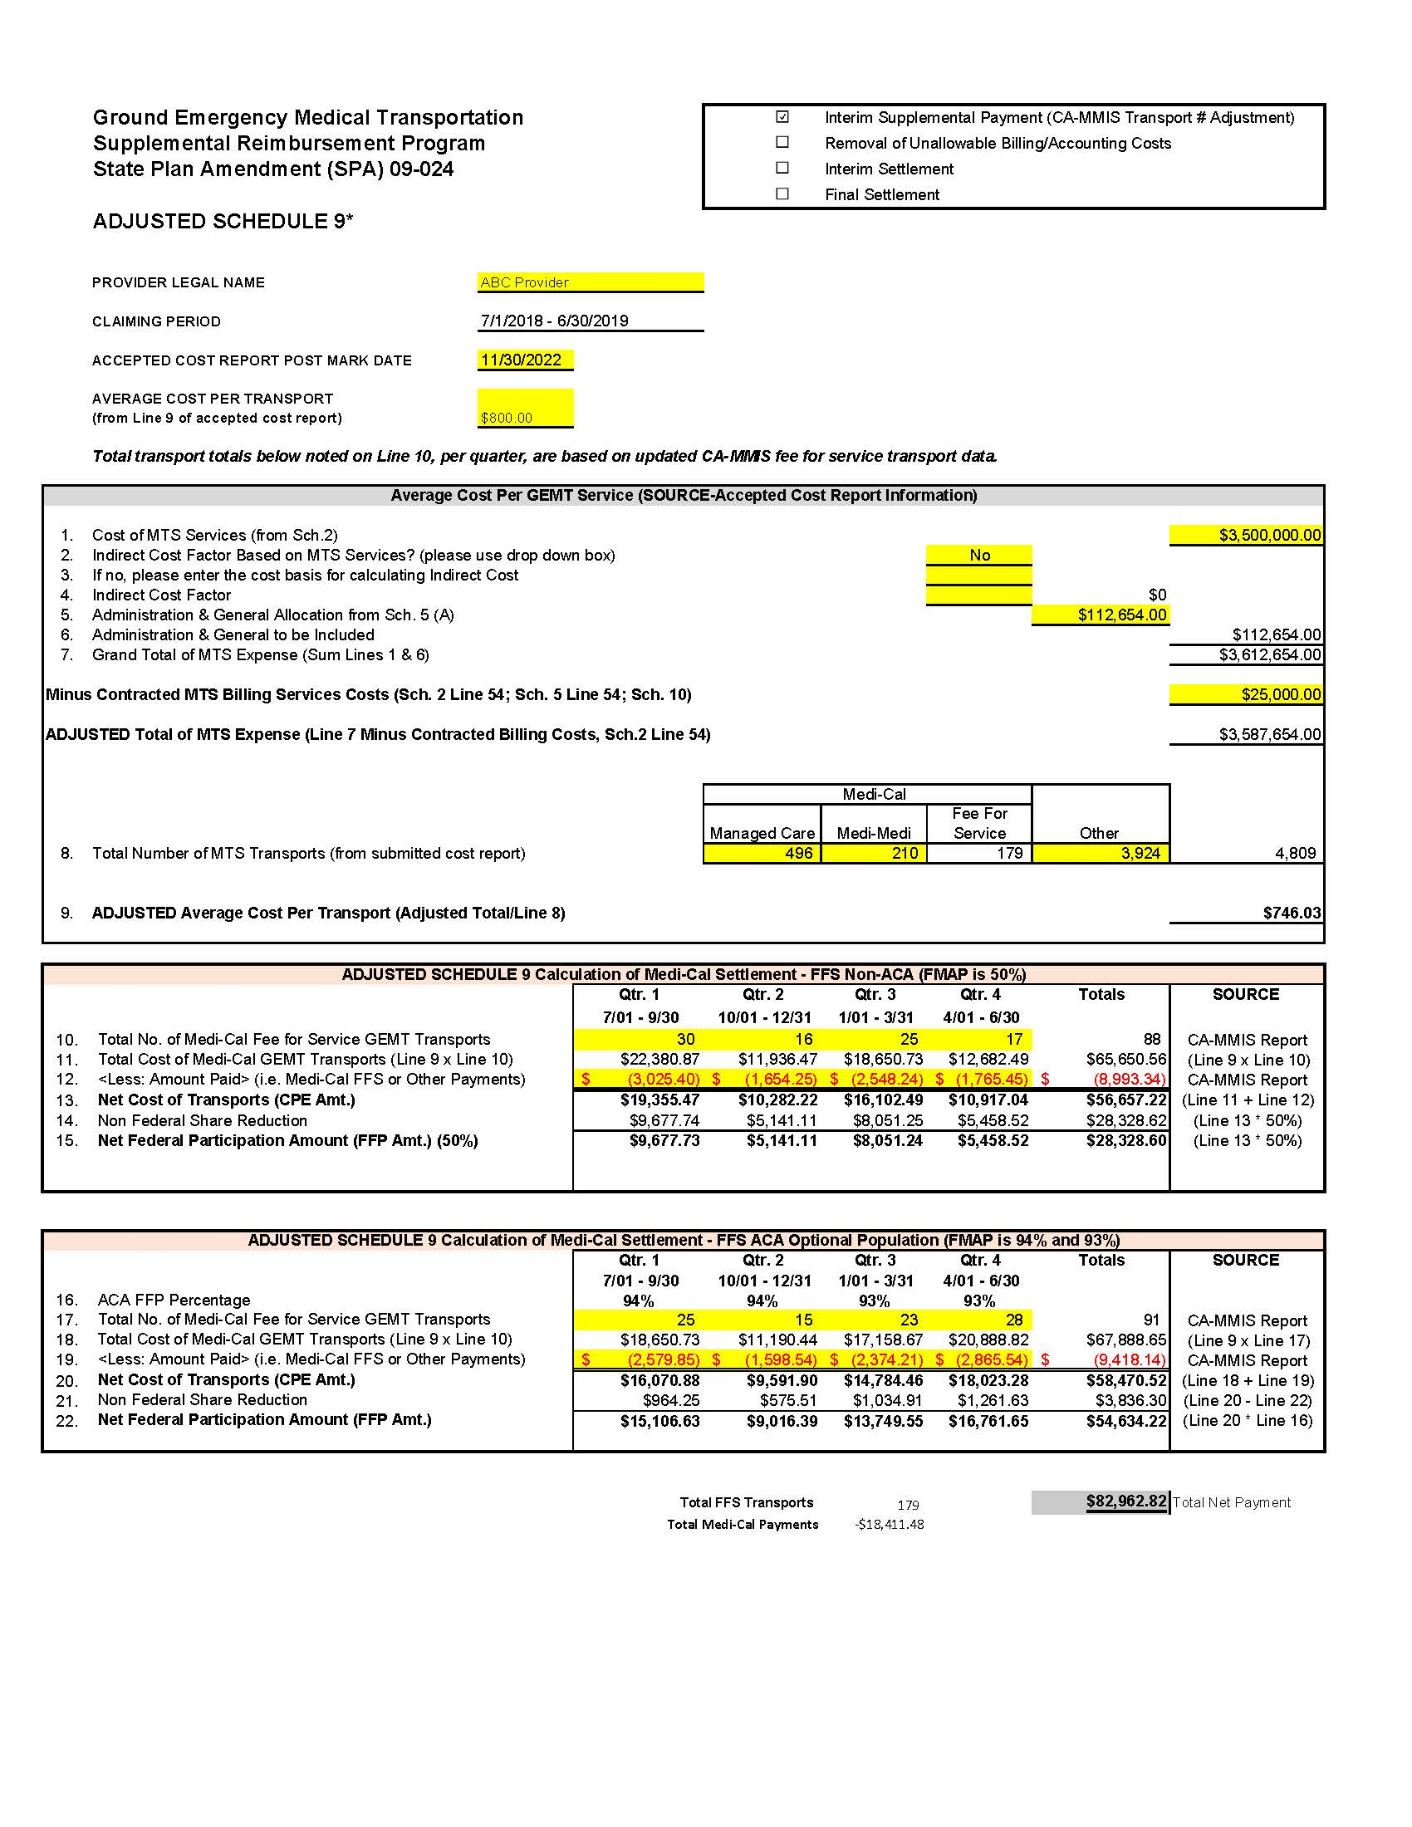
Adjusted Schedule 9

Slide 18
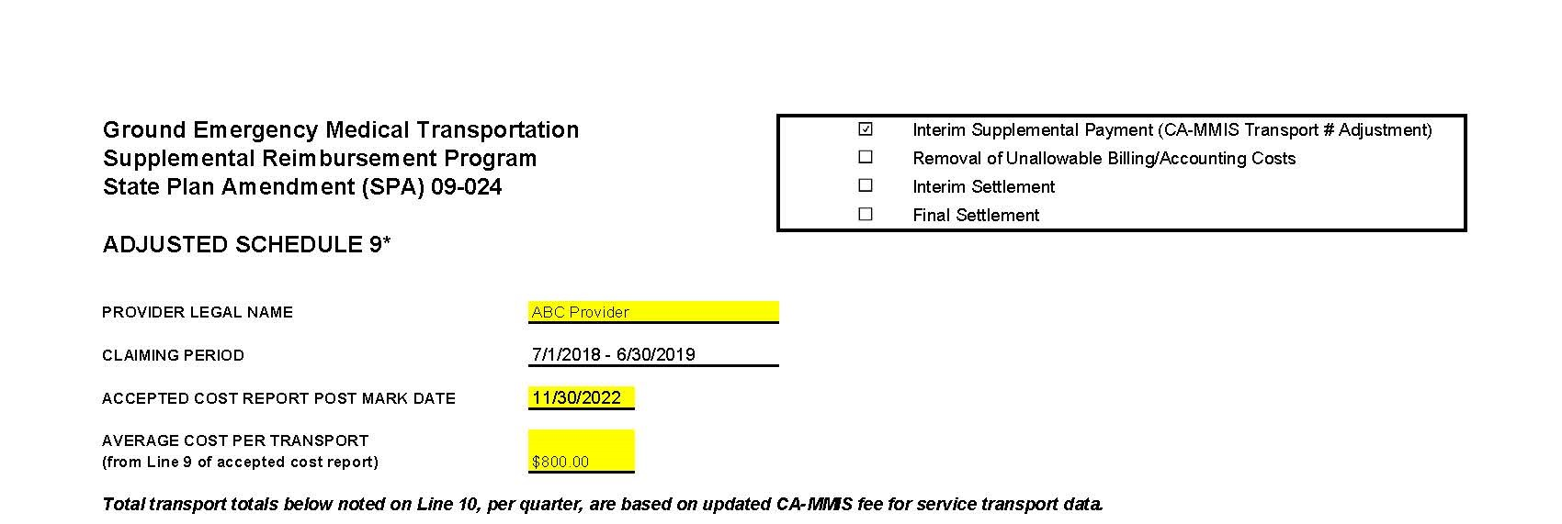
Top of adjusted schedule 9

Slide 19
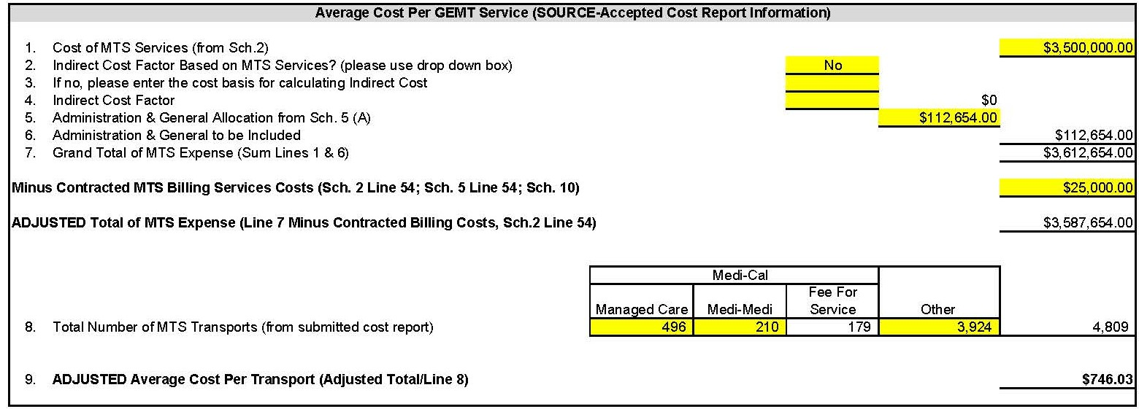
Average cost per transport box

Slide 20
Transport discrepancy
Providers may see a variance in the total FFS transports as there could be a lag in DHCS’ CA-MMIS system-generated report.
Any discrepancy (high or low) in the FFS transports will be adjusted in the ‘other’ category.
  For example, if a provider reported 10 FFS transports and 15 ‘other’ transports and CA-MMIS generated report only showed 8 FFS transports we adjust the FFS transports down to 8 and increase the ‘other’ transports to 17 in an effort to not change the average cost per transport.
Any additional transports that may be eligible, but are not yet captured on DHCS’ CA-MMIS report for interim payments will be addressed during the interim settlement.

Slide 21
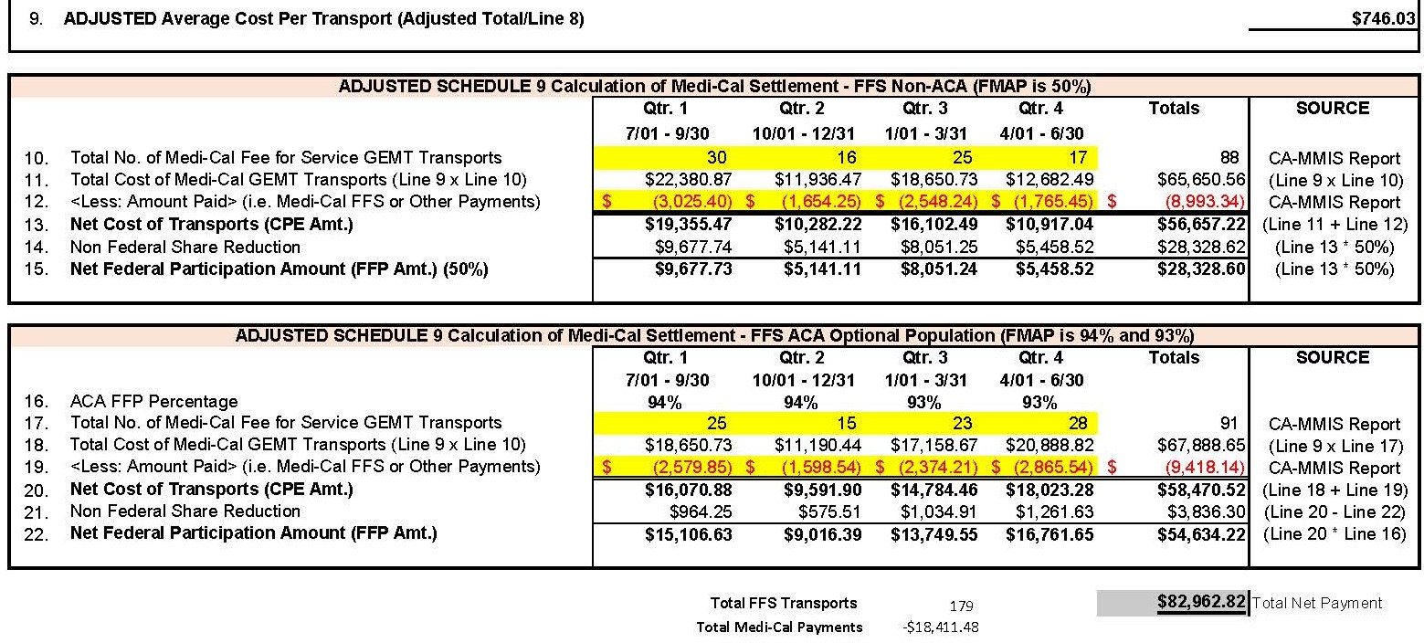
Payment calculation box

Slide 22
Affordable care act
(ACA) FMAP rate
Pursuant to federal law, services for ACA eligible beneficiaries will receive the increased FMAP rate as follows:
  94% for calendar year 2018;
  93% for calendar year 2019; and
  90% for calendar year 2020 and all subsequent calendar years.

Slide 23
Families First Coronavirus Response Act
(FFCRA)
To help support states and promote stability of coverage amidst the COVID-19 pandemic, FFCRA provides a 6.2% increase in the traditional FMAP for the periods listed below:
  SFY 2019-20 Q3 through SFY 2022-23 Q1 (January 2020 through September 2022)
    FFCRA may be extended, so these periods are subject to change.
  This increase will be seen in the Adjusted Schedule 9 when reimbursements are processed by DHCS

Slide 24
Cost report due dates
Cost Reports for SFYs 2018-19, 2019-20, and 2020-21 are due to DHCS by July 31, 2022.
Cost Reports for SFY 2021-22 are due to DHCS by November 30, 2022.

Slide 25
Want more gemt information?
Please visit our website: Medi-Cal Ground Emergency Medical Transportation Supplemental Reimbursement Program
Join our email distribution list: GMET email distribution list
Email questions to GEMT@dhcs.ca.gov

Slide 26
Administration cost
Here with me today is Marie Jones from Metro Fire to talk about the administration cost portion of GEMT.

Slide 27
The end

