Slide 1
Children and Youth Behavioral Health Initiative
Fee schedule working group session 1
October 3, 2022

Slide 2
Purpose:
The purpose of this document is to present next steps for the Office of Strategic Partnership’s BH Fee Schedule workstream as part of the Children and Youth Behavioral Health Initiative. The materials are meant to provide a non-exhaustive fact base around potential stakeholder engagement and preliminary materials for the fee schedule.
This document was created at the request of DHCS Office of Strategic Partnerships. Sources of insight include working sessions with OSP, the DHCS July memo on the BH Fee Schedule, and inputs from CalHHS and other department teams.
The approaches and considerations included in this document are preliminary and may be further developed based on additional inputs from OSP, broader DHCS, CalHHS and other departments.

Slide 3
Welcome!
Draft AS OF 09/23/22
Please add your name and role in the meeting chat!
This Working Group will focus on supporting the design of a school-linked fee schedule in support of CYBHI. The group includes a wide range of perspectives, including:
Xx K-12 (including school-linked providers)
Xx Higher Education (including school-linked providers)
Xx Medi-Cal Managed Care Plans
Xx Other Organizations (e.g. ,NGOs, advocates)
Xx Commercial Health Plans
Xx County Health Plans
Xx CBOs and Afterschool Programs
Xx Counties represented across all major CA regions
Source: Responses to Working Group applications and nominations

Slide 4
Today’s Agenda
Draft AS OF 09/23/22
Topic
Activities
Time
1
Overview and introductions
Review today’s agenda and get to know each other
20 mins
2
Vision for the fee schedule and role of working group
Review background (e.g., legislative requirements, impact on funding, etc.)
Align on role of workgroup and working norms
30 mins
Break
5 mins
Share current hypothesis on scope of services
Discuss open design questions around policy and operations in breakout rooms
3
Policy and operational considerations
55 mins
4
Next steps
Review plan and cadence for following sessions over the next 3 months, including pre-work for next session
10 mins

Slide 5
Today’s Agenda
Draft AS OF 09/23/22
Topic
Activities
Time
1
Overview and introductions
Review today’s agenda and get to know each other
20 mins
2
Vision for the fee schedule and role of working group
Review background (e.g., legislative requirements, impact on funding, etc.)
Align on role of workgroup and working norms
30 mins
Break
5 mins
Share current hypothesis on scope of services
Discuss open design questions around policy and operations in breakout rooms
3
Policy and operational considerations
55 mins
4
Next steps
Review plan and cadence for following sessions over the next 3 months, including pre-work for next session
10 mins

Slide 6
1. Potential success from today’s discussion
Draft AS OF 09/23/22
1
Share vision and context for a school-linked fee schedule for BH services
2
Align on working group charter, including objectives, norms and expectations
3
Discuss major operational questions for the school-linked fee schedule
Source: Discussion with OSP, 09/07/2022

Slide 7
1. Word Cloud Exercise (1 of 2)
Draft AS OF 09/23/22
What word describes something that excites you about the potential future-state of a school-linked fee schedule?
To do: embed Poll Everywhere word cloud
Source: DHCS input

Slide 8
1. Phrase wall exercise (2 of 2)
Draft AS OF 09/23/22
What is a worry/concern you have about implementing a new school-linked fee schedule?
To do: embed Poll Everywhere phrase wall
Source: DHCS input

Slide 9
Today’s Agenda
Draft AS OF 09/23/22
Topic
Activities
Time
1
Overview and introductions
Review today’s agenda and get to know each other
20 mins
2
Vision for the fee schedule and role of working group
Review background (e.g., legislative requirements, impact on funding, etc.)
Align on role of workgroup and working norms
30 mins
Break
5 mins
Share current hypothesis on scope of services
Discuss open design questions around policy and operations in breakout rooms
3
Policy and operational considerations
55 mins
4
Next steps
Review plan and cadence for following sessions over the next 3 months, including pre-work for next session
10 mins

Slide 10
2. Overview of the Children and Youth Behavioral Health Initiative (CYBHI)
Draft AS OF 09/23/22
The goal of the Children and Youth Behavioral Health Initiative is to address the behavioral health challenges facing children and youth by reimagining the systems that support behavioral health and wellness for children, youth, and their families
The initiative will take a whole system approach by creating cross-system partnerships – involving stakeholders from the various systems that support children and youth behavioral health – to ensure that the reimagined ecosystem is children and youth centered and equity focused
Source: California Health and Human Services Agency

Slide 11
2. The CYBHI vision is to reimagine behavioral health and emotional wellbeing
Draft AS OF 09/23/22
Advance Equity
Designed for Youth by Youth
for ALL children, youth, and families in California by delivering equitable, appropriate, timely, and accessible mental health and substance use services and supports from prevention to treatment to recovery in an innovative, up-stream focused, ecosystem
Start Early, Start Smart
Free of Stigma
Center around Children and Youth
Right Time, Right Place
Empower Families and Communities
Source: California Health and Human Services Agency

Slide 12
2. Snapshot of stakeholder engagement to date
Draft AS OF 09/23/22
In 2022 to date, DHCS and DMHC have engaged multiple stakeholder groups (including some participants from this Working Group) regarding school-linked services as a part of CYBHI, including:
8 Listening tours
5 Public-facing webinars
3 higher education roundtable discussions
Conference with the County Behavioral Health Directors Association of California (CBHDA)
Conference with the California Association of Health Plans (CAHP) and Local Health Plans of California (LHPC)
Ongoing stakeholder engagement with K-12 partners through the Education Coalition
Feedback from these sessions has informed DHCS’s understanding of current-state Behavioral Health offerings in school settings.
We are excited to launch this workgroup, which is the first stakeholder group focused exclusively on the design of the school-linked fee schedule
Source: DHCS Public Webinar

Slide 13
2. Current challenges and vision for the school-linked BH fee schedule
Draft AS OF 09/23/22
Current challenges for school-linked BH services
How the Fee Schedule aims to address current challenges
Need for sustainable funding and resource allocation for services that CYBHI aims to promote and scale
School-linked providers can bill to the fee schedule to fund services that are appropriate to provide in schools
Insufficient provider capacity to provide and supervise services
The fee schedule may include coverage for provider types not currently covered (e.g., BH Coaches)
Administrative, logistical, legal, and financial burden from providing BH services, especially for small schools and school-linked providers
The fee schedule uses a more approachable billing model to ease administrative burden of billing services and simplify contracting, rate negotiation, and navigation across delivery
Concerns around fraud, waste and abuse
The fee schedule includes mechanisms for oversight and accountability into fee schedule design
Need to ensure improvement in equity of services
Build funding sources for schools to be a stronger delivery hub that will reach students who are typically underserved by traditional healthcare delivery system
Source: DHCS 2022 stakeholder engagement sessions

Slide 14
2. Fee schedule working group charter
Draft AS OF 09/23/22
Objectives and scope
The Working Group will:
The Working Group will not
Member expectations
Provide input on current-state school-linked BH services billing / reimbursement / contracting processes, including potential challenges
Offer perspectives on select design decisions, including (not exhaustive):
What services are included in the fee schedule?
Who is eligible to provide services?
How are payments made through the fee schedule?
Engage with other stakeholders on the fee schedule implementation plan
Make final design decisions (DHCS and DMHC will decide)
Directly shape decisions around other billing programs (e.g., LEA BOP)
Join all Working Group Sessions on-time
Complete all pre-work and pre-reading before sessions as needed
Do not multi-task during sessions
Maintain confidentiality
Source: Discussion with OSP, 09/07/2022; 08/17/2022

Slide 15
2. Fee schedule working group norms and values
Draft AS OF 09/23/22
Participatory
Commit to participating in discussions, completing “pre-work”, and joining potential follow-up sessions
Collaborative
Work together to facilitate the program design by welcoming others’ perspectives and championing CYBHI
Activity:
Use the Jamboard to add stickies with additional norms for the team, and mark the norms that resonate most with you
Solution-oriented
Anchor discussion on problem solving and brainstorming potential solutions
Open and exploratory
Maintain a safe space for discussion, debate, and risk-taking
Health impact-focused
Center around the impact and outcomes of design decisions for children, youth, and families in California
…
For discussion
Source: DHCS Think Tank sessions

Slide 16
2. Preliminary topics for upcoming sessions
Draft AS OF 09/23/22
Topics for future sessions
Session topics, dates, and agendas may be subject to change
Session 1 (10/3) Kickoff & Overview
Session 2 (10/24) Scope of Services & Provider Network
Session 3 (11/7) Billing & Reimbursement
Session 4 (12/5) Implementation
Post Session 4
Topics for discussion
FSWG charter
Fee schedule background and overview
Policy and operational conditions and success factors
Preview of upcoming sessions and scope of services discussion
Updates and changes from previous session
Provider network considerations, including enrollment and eligibility requirements
Detail on scope of services
Updates and changes from previous session
Billing and reimbursement considerations
Network oversight, including FWA considerations
Updates and changes from previous session
Fee schedule implementation plan for 2024
Additional topics as-needed
Additional, townhalls as-needed through Jan 2024 to flag consid-erations
Source: Input from OSP, 09/07/2022

Slide 17
Today’s Agenda
Draft AS OF 09/23/22
Topic
Activities
Time
1
Overview and introductions
Review today’s agenda and get to know each other
20 mins
2
Vision for the fee schedule and role of working group
Review background (e.g., legislative requirements, impact on funding, etc.)
Align on role of workgroup and working norms
30 mins
Break
5 mins
Share current hypothesis on scope of services
Discuss open design questions around policy and operations in breakout rooms
3
Policy and operational considerations
55 mins
4
Next steps
Review plan and cadence for following sessions over the next 3 months, including pre-work for next session
10 mins

Slide 18
3. Overview of statutory requirements
Draft AS OF 09/23/22
CYBHI Act Statutory requirements¹
Additional factors
Develop and maintain a school-linked statewide fee schedule for outpatient mental health or substance use disorder provided to a student 25 years of age or younger at a school site
Develop and maintain a school-linked statewide provider network of school site behavioral health counselors
Require each commercial health plan AND the Medi-Cal managed care plans and Medi-Cal behavioral health delivery system, as applicable, to reimburse providers of medically necessary outpatient mental health or substance use disorder treatment provided at, or near, a school site to a student (age 25 or younger) who is an enrollee of the plan or delivery system
Providers of medically necessary school-site services will be reimbursed, at a minimum, at the fee schedule rate regardless of network provider status (e.g., commercial plan coverage)
Services provided as part of the fee schedule shall not be subject to copayment, coinsurance, deductible, or any other form of cost sharing²
1. See Children and Youth Behavioral Health Initiative Act, § 5961.4 (a) (1) – (4);
2. See Health and Safety Code § 1374.722
Source: DHCS Public Webinar

Slide 19
3. Preliminary view of scope of services¹ to be covered
Draft AS OF 09/23/22
Additional discussion planned for Workgroup 2
Prevention / early intervention: Care for a student to avoid or reduce the impact of a potential mental health condition or substance use disorder
Ongoing Support: Support groups for students with a shared diagnosis and recovery groups for students in recovery from an SUD
Treatment: Care for a student with an identified mental health condition or substance use disorder
Coordination/ care management: activities by a team of providers and/or social support organizations to coordinate care and other services
1. CYBHI Act of 2021 Section 5961.4 (a)

Slide 20
3. Hypothesis for future-state school-linked fee schedule process flow
Draft AS OF 09/23/22
School or school district enrolls as a provider
Provider delivers services at or near school site
Responsible party bills for services
Plan remits payment at (or above) the established rates
State conducts ongoing audit and accountability
LEA bills for services
Medi-Cal is payer (MCOs, Medi-Cal BH)
School or school district enrolls as a provider in the school-linked network and hires or contracts with medical practitioners eligible for reimbursement under the fee schedule
School or school district provides or arranges for the provision of eligible medically necessary services – on campus, off-campus, mobile, etc.
State monitors for appropriate and timely reimbursement and fraud, waste, and abuse
Third party billing entity bills
Commercial plan is payor
Source: DHCS

Slide 21
3. Design and operational considerations to be addressed
Draft AS OF 09/23/22
School or school district enrolls as a provider
Provider delivers services at or near school site
Responsible party bills for services
Plan remits payment at (or above) the established rates
State conducts ongoing audit and accountability
Designated party for fee schedule reimbursement (e.g., schools, LEAs, COEs, combination)
Provider enrollment requirements and process
Specific scope of services and benefits to be covered
Eligible practitioners and enrollment requirements
Designated central billing entity (e.g., LEAs, practitioners, schools)
Supports and infrastructure needed for educational billing (e.g., potential role of third-party billing entity)
Interaction with other BH funding streams
Model for educational institution engagement with payers
Payer provider network requirements for reimbursement
Appropriate oversight of quality of services
Appropriate fraud protection and network safety measures
Source: DHCS

Slide 22
3. Breakout group discussions
Draft AS OF 09/23/22
You will each be assigned to join one of five pre-assigned breakout groups, each focused on a different step of the potential future-state process:
Provider Enrollment
Service delivery
Billing
Reimbursement
Accountability and oversight
In your breakout groups, please
Select one team member who will report-out at the end
For each topic within your process step, use stickies on Jamboard to answer the following questions:
What would you be most excited to see in the future state?
What policy / operational factors need to be in place to realize that vision?
What outstanding questions should DHCS and DMHC consider?
25 min

Slide 23
3. Breakout discussion activity: Provider enrollment
Draft AS OF 09/23/22
K-12
1
2
3
What would you be excited to see in the future state?
What policy / operational factors need to be in place to realize that vision?
Outstanding questions and considerations for DHCS / DMHC
Higher ed
Topics for discussion
Designated party for fee schedule reimbursement (e.g., schools, LEAs, COEs, combination)
Medi-Cal payers
Activity to be completed on Jamboard
Commercial payers
Provider enrollment requirements and process
Other
...other sub-topics
Source: DHCS

Slide 24
3. Read-out from breakouts
Draft AS OF 09/23/22
For each breakout group, the designated leader should share:
What is one characteristic of the future state that makes you most excited?
What are the 2 - 3 most critical factors for success to realize that vision?
15 min (3 minutes per group)

Slide 25
Today’s Agenda
Draft AS OF 09/23/22
Topic
Activities
Time
1
Overview and introductions
Review today’s agenda and get to know each other
20 mins
2
Vision for the fee schedule and role of working group
Review background (e.g., legislative requirements, impact on funding, etc.)
Align on role of workgroup and working norms
30 mins
Break
5 mins
Share current hypothesis on scope of services
Discuss open design questions around policy and operations in breakout rooms
3
Policy and operational considerations
55 mins
4
Next steps
Review plan and cadence for following sessions over the next 3 months, including pre-work for next session
10 mins

Slide 26
4. School-linked fee schedule implementation preliminary timeline
Draft AS OF 09/23/22
Preliminary Timeframe
Milestone
Considerations
Fee schedule working group sessions
School-linked services grant rounds
Preliminary scope of services and design decisions for fee schedule finalized
Fee schedule published by healthcare finance team
Fee schedule goes live for Medi-Cal
Fee schedule goes live for Commercial Health Plans
Oct-Dec 2022
Oct 2022-Feb 2023
Dec 2022
TBD
Jan 2024
May include a phased roll-out
TBD
Source: Input from OSP, 09/07/2022

Slide 27
4. Preliminary topics for upcoming sessions
Draft AS OF 09/23/22
Topics for future sessions
Session topics, dates, and agendas may be subject to change
Session 1 (today) Kickoff & Overview
Session 2 (10/24) Scope of Services & Provider Network
Session 3 (11/7) Billing & Reimbursement
Session 4 (12/5) Implementation
Post Session 4
Topics for discussion
FSWG charter
Fee schedule background and overview
Policy and operational conditions and success factors
Preview of upcoming sessions and scope of services discussion
Updates and changes from previous session
Provider network considerations, including enrollment and eligibility requirements
Detail on scope of services
Updates and changes from previous session
Billing and reimbursement considerations
Network oversight, including FWA considerations
Updates and changes from previous session
Fee schedule implementation plan for 2024
Additional topics as needed
Additional townhalls as needed through Jan 2024 to flag considerations
Source: Input from OSP, 09/07/2022

Slide 28
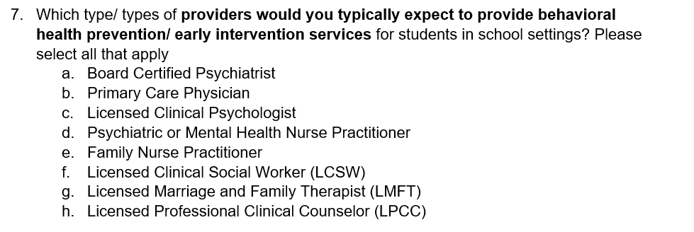
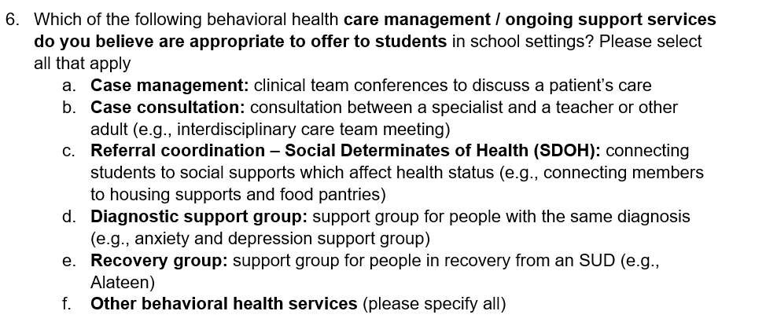
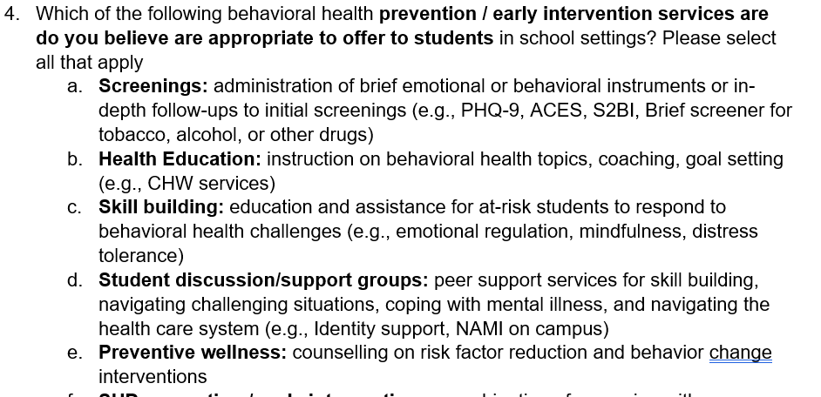
4. Preview of pre-survey for session 2
In session 2, the FSWG will review mental health and substance use services for students 25 years of age or younger that can be provided by school-linked providers for inclusion in the statewide fee schedule.¹
Sample pre-survey questions (subject to change):
Action needed:
Please complete the pre-survey by end of day on Friday, October 14
1. CYBHI Act of 2021 Section 5961.4 (a)
Source: Fee Schedule Working Group Session 1 Pre-Survey, last edited 9/26/2022

Slide 29
Backup

Slide 30
Review: Fee Schedule stakeholder engagement plan
Preliminary as of 09/08/2022
Membership
Key Dates
Objective
The Working Group will:
Total Members: 40-60
Launch:
Application opens; Emails sent to collaborators who will recommend potential invitees: Fri., 9/2
Responses expected back from collaborators who will recommend potential invitees: Wed, 9/7
Application closes: Mon., 9/12
Members notified of selection: Thur., 9/23
Provide input on current-state school-linked BH services billing / reimbursement / contracting processes, including potential challenges
Offer perspectives on key design decisions in consideration for 2023:
What services are included in the fee schedule?
Who is eligible to provide services?
How are payments made through the fee schedule?
Gain opportunity to engage with other stakeholder groups on the fee schedule implementation plan
Stakeholder groups:
~1/3 education partners (including K-12 and higher ed. partners)
~1/3 BH providers BH providers (including K-12 and higher ed. partners)
~1/3 plans (Commercial, Medi-Cal MCPs, and County BH)
Other relevant stakeholders
Sessions:
Session 1: October 3, 3-5pm
Session 2 (Higher ed.): October 10, 2:30-5:30pm
Session 3 (K-12): November 7, 3-6pm
Session 4: December 5, 3-6pm
Potential additional ~bi-monthly townhall-style sessions in 2023
Profiles sought:
Technical roles, including Heads of Managed Care for MCPs / MHPs, School and Provider billing/admin leads
Participant selection:
DHCS and DMHC to identify participants through nominations from key partners (e.g., CAHP, LHPC, Ed. Coalition) and open application
The Working Group will NOT:
Make the final key design decisions (DHCS and DMHC will decide)
Source: DHCS announcement

Slide 31
2. Potential impacts of a revised school-linked fee schedule on current billing processes
Draft AS OF 09/23/22
What may stay the same with a school-linked fee schedule¹
What may change with a school-linked fee schedule
For payers (e.g., Medi-Cal, commercial plans, county BH):
Current billing programs including LEA BOP and the Medi-Cal fee schedule remains in place and unchanged
Payer designation by service remains in place
State handles oversight against fraud, waste and abuse
For educational institutions (e.g., LEAs, colleges, universities):
Educational institutions or billing entities (in-house department or TPA) bill through traditional Medi-Cal FFS system for reimbursement
Educational institutions are central providers w/ NPI and managing certification / compliance requirements, budget projection, DUA
Educational institutions hire / contract with providers, provide services and pay for services prior to reimbursement
A wider range of services from a wider range of providers may be billable
Fee schedule may supersede existing payment mechanisms for school-linked BH services (e.g., the Medi-Cal fee schedule)
Ed. institutions might not be subject to annual cost settlement processes for BH services (e.g., through LEA BOP)
Educational institutions may need to maintain insurance status of all students
Commercial plans could work more closely with educational institutions to coordinate billing
1. For educational institutions that are currently billing for behavioral health services
Source: Discussion with OSP, 09/07/2022; September DHCS Fee Schedule Memo

Slide 32
4. Instructions for Scope of Services breakout groups
Draft AS OF 09/23/22
20 minutes for discussion
1. Select a team member who will report-out at the end
2. Use stickies on Jamboard to answer these questions:
What additional major categories of prevention & early intervention services should be offered in school-linked settings?
Are any services on this list not appropriate to deliver in a school-linked setting?
Are there specific policy and operational issues to consider in order to deliver and seek reimbursement for these services?
What are specific examples of services to include within the category?
What types of providers who typically provide the service?
Source: Discussion with OSP, 09/07/2022

Slide 33
4. Prevention & early intervention
Draft AS OF 09/23/22
Potential category of service
For discussion
Screenings: administration of brief emotional or behavioral instruments or in-depth follow-ups to initial screenings (e.g., PHQ-9, ACES, S2BI, Brief screener for tobacco, alcohol, or other drugs)
What additional major categories of prevention & early intervention services should be offered in school-linked settings?
Are any services on this list not appropriate to deliver in a school-linked setting?
Are there specific policy and operational issues to consider in order to deliver and seek reimbursement for these services?
Health Education: instruction on behavioral health topics, coaching, goal setting (e.g., CHW services)
Wellness and skill building: education and assistance for at-risk students to respond to behavioral health challenges (e.g., emotional regulation, mindfulness, distress tolerance)
Student discussion/support groups: Peer support services for skill building, navigating challenging situations, coping with mental illness, and navigating the health care system (e.g., Identity support, NAMI on campus)
Preventive wellness: individual or group risk factor reduction and behavior change interventions (e.g., Mind Matters)
SUD pre-clinical intervention: a combination of screening combined with psychoeducation and/motivational interviewing (e.g., ASAM 0.5 programs and SBIRT)
Sources: DHCS and DMHC stakeholder conversations
Expert interviews
Agency for Healthcare Research and Quality (AHRQ)

Slide 34
4. Prevention & early intervention
Draft AS OF 09/23/22
Specific examples of services to include within the category
Providers who typically provide service
Potential category of service
Screenings
Health Education
Wellness and skill-building
Student discussion/support groups
Preventive wellness
SUD pre-clinical intervention
…
Sources: DHCS and DMHC stakeholder conversations
Expert interviews
Agency for Healthcare Research and Quality (AHRQ)

Slide 35
4. Treatment
Draft AS OF 09/23/22
Potential category of service
Assessments: administration of an assessment (e.g., brief emotional/behavioral assessment, developmental, neurobehavioral, neuropsychological, SUD)
For discussion
What additional major categories of treatment services should be offered in school-linked settings?
Are any services on this list not appropriate to deliver in a school-linked setting?
Are there specific policy and operational issues to consider in order to deliver and seek reimbursement for these services?
Counselling/ Therapy: standard psychotherapy session (e.g., Individual, group or family psychotherapy)
Medication management: pharmacological management including prescription use and review of medication
Team consultation: consulting services provided to the treating provider or school-based team serving a student
Family/dyadic services: services that support the family and therefore the health of the student (e.g., Parent Child Interaction Training, Positive Parenting Program)
Mobile crisis services: community-based intervention designed to provide de-escalation and relief to individuals experiencing a behavioral health crisis wherever they are, including at school
Evidence based therapy, CBT: Treatment delivered according to a defined CBT protocol (e.g., CBITS, MET-CBT, or trauma focused CBT
SUD treatment: ASAM level 1 service to treat a student’s SUD (e.g., Counselling / Therapy; Medication Management; Psychiatric consultation)
Sources: DHCS and DMHC stakeholder conversations
Expert interviews
Agency for Healthcare Research and Quality (AHRQ)

Slide 36
4. Treatment
Draft AS OF 09/23/22
Specific examples of services to include within the category
Providers who typically provide service
Potential category of service
Assessments
Counselling/ Therapy
Medication management
Team consultation
Family/dyadic services
Mobile crisis services
Evidence-based therapy, CBT
SUD treatment
…
Sources: DHCS and DMHC stakeholder conversations
Expert interviews
Agency for Healthcare Research and Quality (AHRQ)

Slide 37
4. Coordination/care management and ongoing support
Draft AS OF 09/23/22
For discussion
Potential category of service
What additional major categories of coordination/ case management services should be offered in school-linked settings?
Are any services on this list not appropriate to deliver in a school-linked setting?
Are there specific policy and operational issues to consider in order to deliver and seek reimbursement for these services?
Case management: clinical team conferences to discuss a patient’s care
Case consultation: consultation between a specialist and a teacher or other adult (e.g., interdisciplinary care team meeting)
Referral coordination – Social Determinates of Health (SDOH): connecting students to social supports which affect health status (e.g., connecting members to housing supports and food pantries definition)
Diagnostic support group: support group for people with the same diagnosis (e.g., anxiety and depression support group)
Recovery group: support group for people in recovery from an SUD (e.g., Alateen)
Sources: DHCS and DMHC stakeholder conversations
Expert interviews
Agency for Healthcare Research and Quality (AHRQ)

Slide 38
4. Coordination/care management and ongoing support
Draft AS OF 09/23/22
Specific examples of services to include within the category
Providers who typically provide service
Potential category of service
Care management
Case consultation
Referral coordination – Social Determinates of Health (SDOH)
Diagnostic support groups
Recovery groups
…
Sources: DHCS and DMHC stakeholder conversations
Expert interviews

